Slide 1


Fairness in Machine Learning for Healthcare #FairMLHealth
Muhammad Aurangzeb Ahmad^{1,2}, Carly Eckert MD MPH^{1,2}, Christine Allen¹, JuHua Hu², Vikas Kumar¹, Arpit Patel MD³, Ankur Teredesai^{1,2}
1) KenSci Inc. 2. Department of Computer Science and Systems, University of Washington Tacoma

Slide 2
#FairMLHealth Tutorial Overview
Foundations: Fairness in Healthcare ML
Measurement & Mismeasurement of Fairness
Operationalizing Fairness in Healthcare ML
Domain Challenges in Healthcare ML
Fairness in Healthcare ML in Action
Best Practices
Library Demo
Conclusion

Slide 3
Foundations: Fairness in Healthcare ML

Slide 4

Audience Poll
How many people in the audience?
Are Physicians/MDs
Work in the healthcare domain
Have built a machine learning model
Work with healthcare data
Plan to work with applied AI/ML in healthcare in the near future

Slide 5




Elements of Responsible AI in Healthcare
Explainability & Transparency
Fairness &
Unbiased
Robustness
Privacy & Security
Notes:
Today we are facing unprecedented times. We were not prepared for a viral pandemic such as COVID-19 and its implications are being felt around the world. Inequity in healthcare has been an epidemic in our society for the last thousands of years ever since healthcare was institutionalized as a discipline. In a similar way rapid advances in AI and its use in not just healthcare but within multiple domains is both an opportunity as well as cause for concern. We see the need for developing AI responsibly everywhere.

Slide 6


Elements of Ethical ML in Healthcare
Explainability & Transparency
Fairness &
Unbiased
Robustness
Privacy & Security
Notes:
I am fortunate to have been able to lead this team from KenSci and the University of Washington Tacoma working on making elements of AI more ethical for the last few years together.
And KDD is our home to disseminate many of these advances. In 2018 in London we conducted our first tutorial on the topic of explanability in healthcare ML. Our focus then was to shine the light on need for open interpretable models in healthcare. Over the last two years we have been working on iterations to the ethics in AI problem and today we are proud to announce the launch of this tutorial on fairness and unbaised Ml for healthcare. In the coming years we intend to continue on this focus bringing in elements of robustness and secure machine learning for healthcare.

Slide 7
Fairness in Machine Learning in General
Classification
Regression
Ranking
Recommendation
Bandit Learning
Reinforcement Learning
NLP
Clustering
Representational Learning
Causal Inference
Notes:
More than 90% of all the literature in Fairness in Machine Learning in General is in the classification setting

Slide 8
Fairness in Machine Learning in General
Classification
Regression
Ranking
Recommendation
Bandit Learning
Reinforcement Learning
NLP
Clustering
Representational Learning
Causal Inference
Notes:
We will mostly focus on Fairness in Machine Learning in healthcare within the classification setting as majority of the literature is in this area

Slide 9
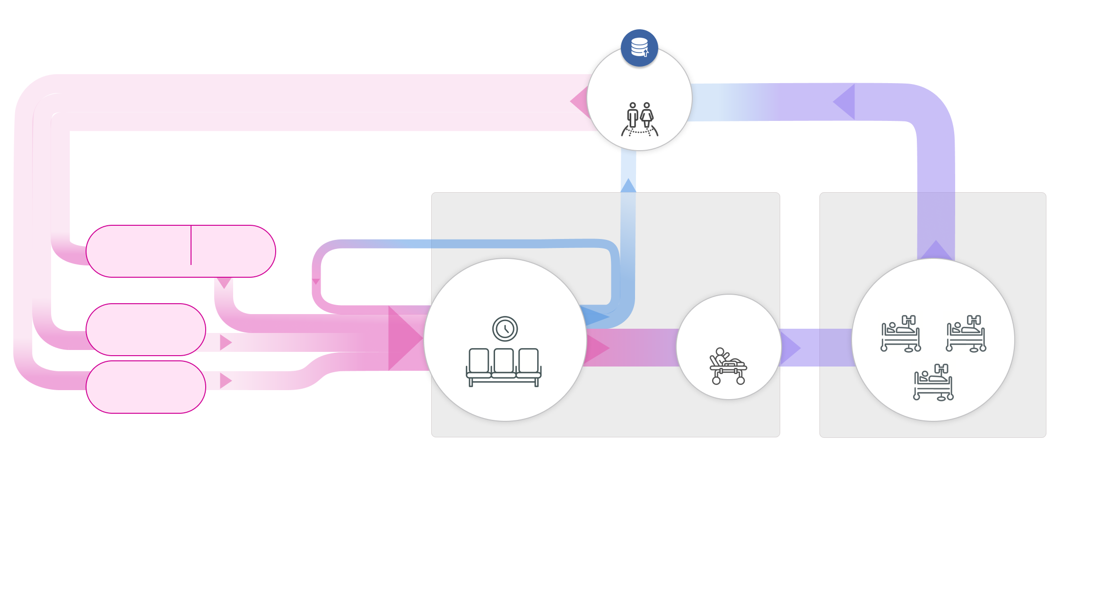

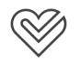
The Spectrum is not Discrete – AI across the Healthcare Continuum
Early Detection and Proactive Intervention to Keep Citizens Healthy
Citizens
Screening
Proactive Intervention
Medical Attention
Healthy
Early Onset
Diagnosed
Notes:
But first let’s get a working definition of healthcare. We often think of healthcare as care needed when the human body goes crazy. Many of us think of this like fixing the engine or the transmission when a car is broken. We often don’t think of healthcare being on a spectrum. From early detection to proactive prevention the term wellness often reflects the goal of AI driven decision making across the continuum of care.

Slide 10
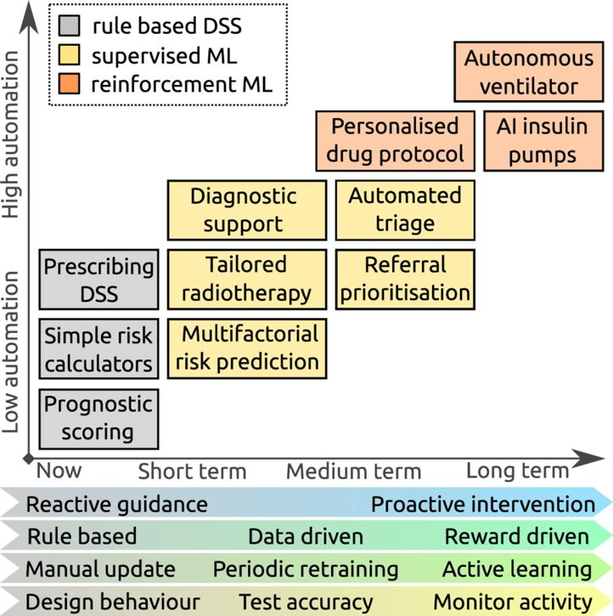
Assistive Intelligence
Expected trends in machine learning (ML) research: boxes show representative examples of decision support tasks that are currently offered by rule-based systems (grey), and hypothetical applications of ML systems in the future (yellow and orange), demonstrating increasing automation.
Robert Challen et al. BMJ Qual Saf 2019;28:231-237
Notes:
This is one view of that future of healthcare AI. X axis is time and the Y axis is the amount of automation or as I like to call it Assistive Intelligence
Today we live in a world of rule-based systems shown in grey. Increasingly in the coming decade we are already noticing the use of machine learning in systems for diagnostic decision support tools. In another two decades or even sooner we will see autonomous ventilators and AI driven insulin pumps that will be clinically approved. The era of proactive intervention will subsume the inefficiencies of reactive guidance.

Slide 11
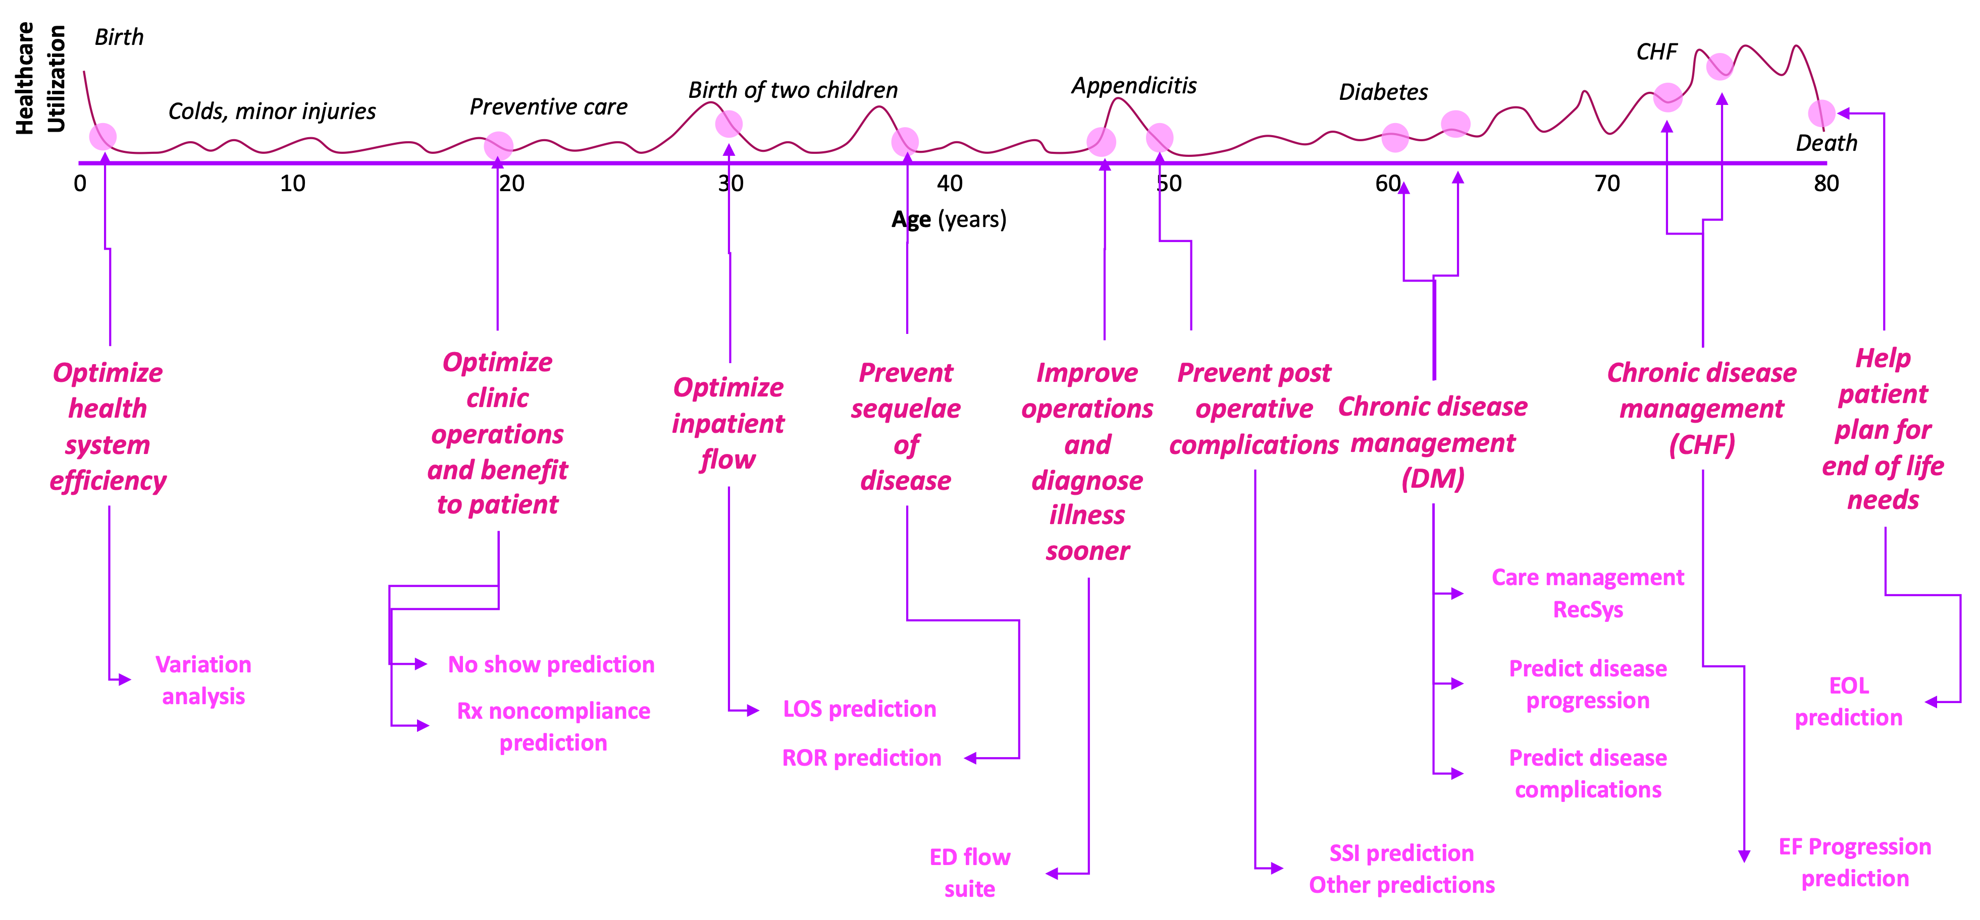
Continuum of Care & AI
[A. Teredesai w Eckert et al, w Ahmad et al, w Frichman et al, w Basu Roy et al]
Notes:
Over the last decade I’ve worked closely with numerous health systems across the world and realized that every stage of the continuum of care, from birth to death and everything in between, has a corresponding objective function. In fact every prediction problem in healthcare has multiple objective functions depending on who the user or end consumer of the model output is: clinician prescribing labs, nurse practitioner raising an alarm for code blue, a social worker helping a diabetes patient get screened regularly to patients themselves who may be nudged differently by their fitbit and apple watches depending on when they last went for a run. AI will integrate and interfere with the practice of medicine. So we must now be very careful in how we create solutions for healthcare.

Slide 12
“We are concerned about the constant use of federal funds to support this most notorious expression of segregation. Of all the forms of inequality, injustice in health is the most shocking and the most inhuman because it often results in physical death.”
- Reverend Martin Luther King Jr. (Chicago, March 25, 1966)
Source: Multiple newspaper article reports. https://quoteinvestigator.com/2015/10/22/mlk-health/
Notes:
And one of the things we have to be very careful about is what Dr. Martin Luther King Jr. was highlighting 54 years ago.. He said - to quote “ Of all the forms of inequality, injustice in health is the most shocking and inhuman..

Slide 13
Motivation
Bias, Discrimination and Unfair practices in healthcare is centuries old
With the integration of AI + Healthcare the potential to discriminate and perpetuate unfair and biased practices in healthcare increases many folds
The problem healthcare AI is a multi-faceted systems level problem that necessitates careful consideration of different notions of fairness in healthcare to different conceptions of Fairness concepts in AI
Notes:
Imagine an emergency room on a Monday morning in a large US city downtown. Amongst other patients with severe wounds and trauma waiting to be seen by an attending physician, are three patients with mild chest pain also waiting. Now imagine the triage nurse is using your AI model to help her bring to attention the most severe patient. It has been shown in numerous studies that rule based systems that don’t use ML have a very low precision for such problems, so the hospital is now using a more precise ML algorithm to help streamline the flow and improve outcomes. After using the system for a few months there seems to be a problem. The model always fails to correctly risk stratify the severity of illness for a specific race and gender when trying to select who to prioritize. This is inspite of having recent data on which the model was trained. This problem is very real. The city is Chicago and the model was later revised when we realized that chest pain factors we were using were from prior studies that did not include any black males. Bias, discrimination and unfair practices in healthcare are not hypothetical.

Slide 14
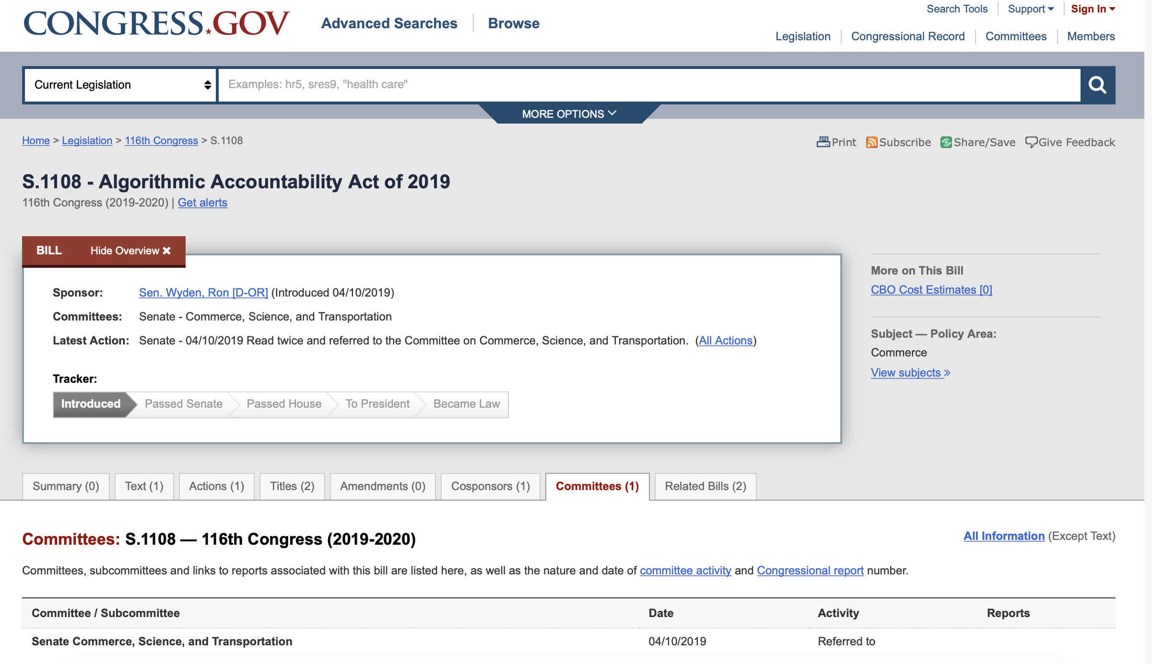
The Algorithmic Accountability Act
“Under the bill, the FTC could require companies to perform “impact assessments” on their own algorithmic decision-making systems. Such assessment would assess potential consequences for “accuracy, fairness, bias, discrimination, privacy and security” within automated systems and companies would be required to correct any issues they uncovered during the process.”
Notes:
In fact policy makers across the world are also becoming increasingly aware of the issue of AI adoption roadblocks and see algorithmic accountability as an important topic. While we know about GDPR and the EU regulation, even the US Congress has been trying to pass the Algorithmic Accountability Act which would mandate accountability of algorithmic systems. The relationship of this with HIPAA and other laws that address patient privacy needs to evolve.

Slide 15
Bias & Discrimination in Healthcare: History
The seminal figures of modern medicine (Anton van Leeuwenhoek⁽¹⁶³²⁻¹⁷²³⁾, the Father of Microscopy, Marcello Malphighi⁽¹⁶²⁸⁻¹⁶⁹⁴⁾, the Father of Histology, Carl Linnaeus⁽¹⁷⁰⁷⁻¹⁷⁷⁸⁾ the Father of Biological Classification) held racial and biased beliefs that greatly influenced modern medicine and healthcare (Byrd 2001)
Education: Many Western physicians assumed poor health as normal for Black ("Negro Diseases”). In Medical Schools syllabus until the 1960s in the US
Medical Profession: With few exceptions Blacks were not represented in the medical profession in the US until the last 19th century and the percentage in the profession remained at 2% from 1900 to 1980
Sterilization: A third of Puerto Rican women of childbearing age were sterilized under coercion from 1930s to 1970s. Many Mexican and Native American women were also sterilized (de Malave 1999). International examples of ethnic sterilization are also plenty (India ‘70s)
Fatality: Higher cases of death during childbirth and lower birth weight among Black Women (Randall 1995)
Notes:
There are racial and biased statements against Black people in pretty much all ancient medical literature be it Greek, Indian, Arab, Chinese
The roots of modern bias and discrimination go all the way back to the birth of modern science
Representation of Blacks in the medical profession was non-existent in the West which made perpetuation of bias easier/worse

Slide 16
Bias & Discrimination in Healthcare: History
Tuskegee Experiments: From 1932 to 1972, the US government tracked and lied to 600 hundred low-income African-American men in Tuskegee, AL on a study where sham treatments were given for Syphilis. Many men needlessly passed the disease to family, suffered and died (Thomas and Quinn 1991)
Sickle cell disease: which mostly affects African-Americans, received less attention in research than other prominent diseases, mainly because its disproportionately affected African-Americans (Wailoo 2017)
Bypass Surgery: Black men are significantly less likely to be recommended for bypass surgery than White men. Mainly because of the incorrect perception Black patients were less well-educated and less likely to engage in physical activity after the surgery. Thus, the physicians concluded that they were poorer candidates for the surgery (Malat and Griffin 2006)
Notes:
Healthcare is rife with inequality and racial prejudice. Three examples of this are presented here. The Tuskegee study is deplorable, Sickle cell was understudies for a long time and human bias led to discriminatory selection for candidates for bypass surgery. These are but a few examples of issues ML and AI will have to broadly address when we think of fairness in healthcare ML. The main point I am driving towards as you can tell by now is that designing techniques that address the issues in data are not going to be enough to design Fair and Trustworthy AI systems for healthcare.

Slide 17
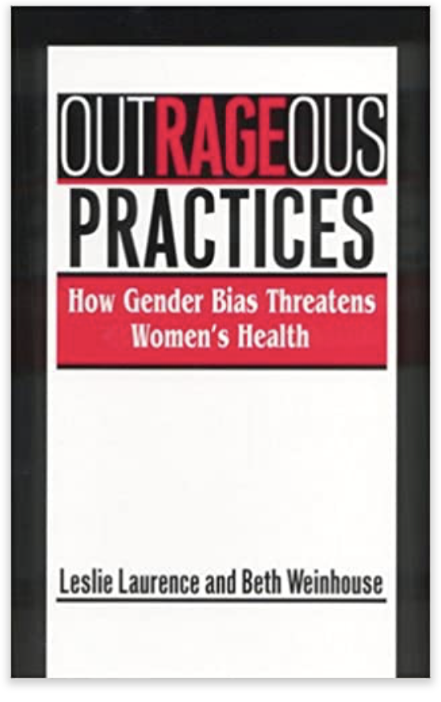
Bias in Healthcare: Examples
Rockefeller University’s NIH supported study on how obesity affected breast and uterine cancer did not enroll any woman (Simkin 1995)
It was found that older women were less likely to be given lifesaving interventions as compared to men (Bierman 2007)
It has been observed that women are less likely to be given analgesia (Chen 2008)
The 1982 Multiple Risk Factor Intervention Trial aimed at exploring whether dietary change and exercise could help prevent heart disease included no women out of trial size of 13,000
Source: https://nypost.com/2018/04/21/medical-research-has-a-woman-problem/
Notes:
And its obviously not just race. Gender discrimination has also played a major role in delivery of healthcare. According to a 2009 analysis US women make up just 37% of research subjects even though they comprise of more than half of the US population.

Slide 18
Bias in Healthcare: Examples
For most of the 15 leading causes of death in the US including heart disease, cancer, stroke, diabetes, kidney disease, hypertension, liver cirrhosis and homicide, Blacks have higher death rates than whites (Kung et al. 2008)
These elevated death rates exist across the life-course with African Americans and American Indians having higher age-specific mortality rates than whites from birth through the retirement years [Williams 2005]
Experiencing racist treatment is also a social determinant of health. Experience of interpersonal racism has been observed as a mechanism that partially explains differences between Aboriginal and non‐Aboriginal people’s health [Larson et al 2007]
There is a long history of unfair diagnosis of psychological conditions in minorities and women [Gard et al 1997]

Slide 19
Bias in Healthcare AI: History
One of the earliest examples (1970s) of algorithmic discrimination comes from healthcare where an algorithm employed by St. George’s Hospital Medical School in the UK was discriminating based on race and gender in making initial screening decisions for applicants to medical school
In 1976 Joseph Weizenbaum was one of the first computer scientists to raise the question of algorithmic bias (Weizenbaum 1976)
Clinicians are more likely to believe AI that supports current practices and thus perpetuate implicit biases (Parikh 2019)
Among women with breast cancer, Black women have a lower likelihood of being tested for high risk mutations compared with Caucasian women. An AI model that uses genetic tests is more likely to mischaracterize the risk of breast cancer, although the risk is the same for both (Parikh 2019)
Notes:
To stress the point home, medicine is not alone in this. Computer Science has also played a role. Algorithmic discrimination goes all the way back to the 1970s.
The literature of fairness and bias in ML started to appear in the late 1990s – early 2000s.
It was not until the 2010s that it became a prominent subjection in the AI/ML community and recent articles are starting to shine the light on the issue. The role of this community will go a long way in shaping the solutions.

Slide 20
Bias in Healthcare AI: History
Idahoans with cognitive/learning disabilities had their healthcare benefits reduced by $20—30K based on AI without any explanation which led to a lawsuit by ACLU that revealed that the decisions were made by an AI [Stanley 2017]
Notes:
Stanley, Jay. "Pitfalls of artificial intelligence decision making highlighted in Idaho ACLU case." Privacy & Technology (2017).

Slide 21
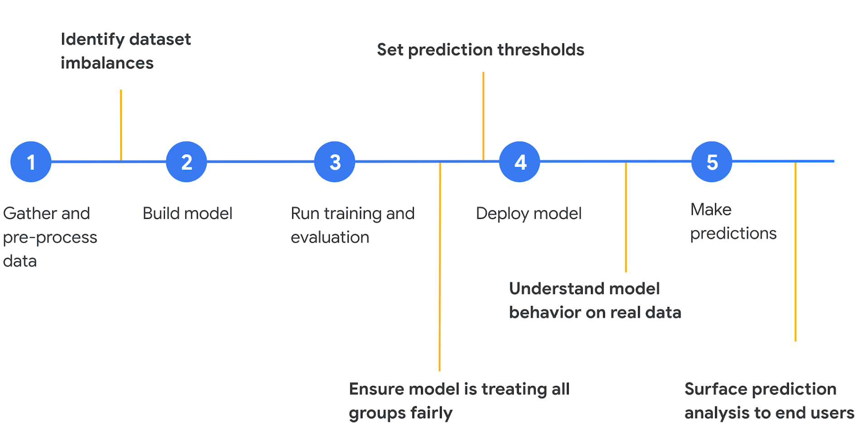
Fairness in Machine Learning is more than imbalanced datasets!
[Google Cloud 2018]
Notes:
My Main message: Its just not the dataset that impacts fairness but rather every element in the machine learning pipelines effects fairness e.g., pre-processing, algorithms, usage etc.

Slide 22
Bias in Healthcare AI: Is it just a data problem?
Generalizability and representativeness are also important considerations when interpreting randomized clinical trials. The generalizability of AI algorithms across subgroups is critically dependent on factors like representativeness of included populations, missing data, and outliers.
EHRs are observational databases, the data reflects not just the health of the patients but also their interactions with the healthcare system e.g., the date of a code for diabetes is when the physician made the diagnosis, not when the patient first developed the disease (Agniel 2018)
The billing code used for an office visit might be influenced more by reimbursement policies than the original reason for the visit
Practices regarding how data is recorded may change over time e.g., reporting patient falls, opioid prescribing increased from 2005-12, but at rates that differed by practice and patient population [McLintock 2019]
Data as a signal. Lab tests are ordered more often for sick patients (Agniel 2018)

Slide 23
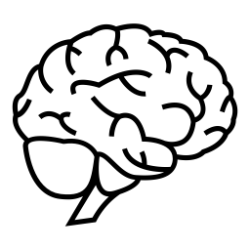
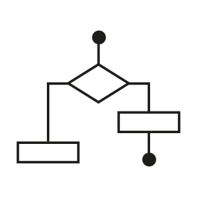


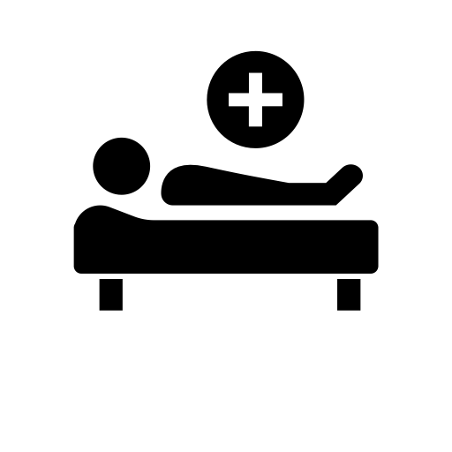

Fairness in ML as a Systems Problem
AI Solution
User
User
Data
Algorithm
Model
Intervention
Each constituent element can contribute towards making the solution unfair or biased
Use Case
Context

Slide 24
Legal Protected classes
Race (Civil Rights Act of 1964)
Color (Civil Rights Act of 1964)
Sex (Equal Pay Act of 1963; Civil Rights Act of 1964)
Religion (Civil Rights Act of 1964)
National origin (Civil Rights Act of 1964)
Citizenship status (Immigration Reform and Control Act 1965)
Age (Age Discrimination in Employment Act of 1967)
Familial status (Civil Rights Act of 1968)
Disability status (Rehabilitation Act of 1973; Americans with Disabilities Act of 1990)
Pregnancy (Pregnancy Discrimination Act 1978)
Veteran status (Vietnam Era Veterans' Readjustment Assistance Act of 1974; Uniformed Services Employment and Reemployment Rights Act of 1994)
Genetic information (Genetic Information Nondiscrimination Act of 2008)
[Solon Barocas and Moritz Hardt 2017]

Slide 25
Fairness in the age of COVID19
Healthcare rationing: Due to stresses caused by the COVID-19 pandemic on national healthcare systems globally
When the limited resources in acute medical settings cannot be accessed by all patients who need them healthcare rationing is unavoidable.
Real Use Case: What happens when ICU demands exceeds the treatment facilities available? How should doctors decide between which patients to treat?

Slide 26
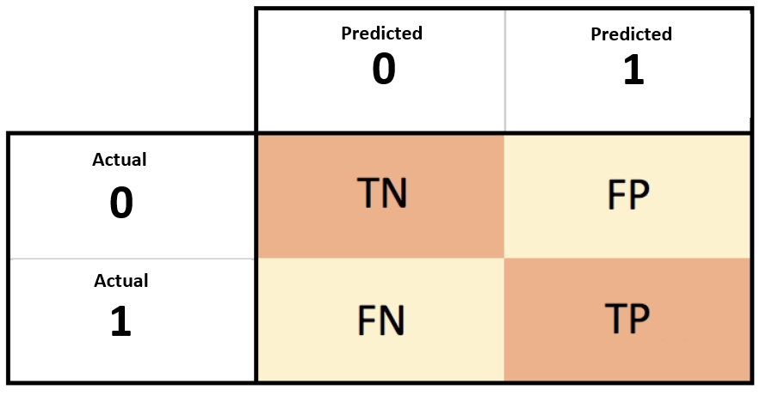
Fairness is Stakeholder Dependent
Physician: Of the patients that are labeled high risk for diabetes, how many are likely to be high risk?
Patient: What is the probability that I will be incorrectly labeled as low risk? Given that I am from a protected class, will I be given the same clinical services according to best evidence
Societal (Group Fairness): Are the risks balanced across all protected classes?
[Narayanan 2018]

Slide 27
Dimensions of Fairness in Healthcare AI
Computational
Data Bias
Model Bias
Loss Function Bias
Post-Hoc optimization
Social
Structural Bias
Embedded Practices
Cognitive
Automation Bias
Automation Complacency
Delivery Bias
Computational
Social
Cognitive
Notes:
This is our own distillation of dimension of fairness in Healthcare AI.
The social, cognitive and computational aspects of the AI model/process taken together determine fairness
Social Factors
Structural and systematic biases in the society e.g., Black people having less access to healthcare. Studies have shown that for certain cancers patients who live farther from hospitals have fewer visits and less healthcare in the long terms. This effects POC more than Whites
Cognitive Factors
Automation Complacency: The term complacency originated in references in the aviation community to accidents or incidents in which pilots, air traffic controllers, or other operators purportedly did not conduct sufficient checks of system state and assumed “all was well” when in fact a dangerous condition was developing that led to the accident. Technically, the performance consequence could also involve not an omission error but an extremely delayed reaction.
Automation Bias: Quite often, however, decision aids are misused, for two main reasons. First, the automatically generated cues are very salient and draw the user’s attention. Second, users have a tendency to ascribe greater power and authority to automated aids than to other sources of advice.
REF: Complacency and Bias in Human Use of Automation: An Attentional Integration

Slide 28
Sources of Bias in Healthcare AI
Data Bias
Non-Data Biases
Model Bias
Loss Function Bias
Post-Hoc optimization
Bias in Delivery
Cognitive Biases
Social Biases
Bias in the ML Cycle
Selection/sample bias
Response bias
Publication bias
Prejudicial bias
Measurement bias
Hawthorne effect
Social desirability bias
Self-reporting bias
Algorithmic Bias
Loss Function Bias
Post-Hoc Optimization
Outcome Fairness
Lack of Understanding
Explainability
Lack of understanding/ Assume model is fair
Don't care
Sources of Bias
Equal representation
Bias mitigation Algorithms
Fairness metrics
Explainable AI
Acknowledgement & Explanation of bias during model delivery
Bias Mitigation
Notes:
Selection/sample bias - selection of individuals, groups or data for analysis in such a way that proper randomization is not achieved, thereby ensuring that the sample obtained is not representative of the population intended to be analyzed
Response bias - tendency for participants to respond to tests or assessment items based on some factor other than the content; also, there is a consistent difference between those who agree to provide responses and those who refuse
Publication bias - there is a greater likelihood that studies with positive results will be published
Prejudicial/Latent bias - training data content is influenced by stereotypes or prejudice within the population
Measurement bias - a systematic measurement error (e.g. offset baseline) that skews all data
Hawthorne effect - the alteration of behavior by the subjects of a study due to their awareness of being observed
Social desirability bias – desire for participants to respond to potentially private or sensitive topics in a manner that seeks approval, especially in cases where anonymity and confidentiality cannot be guaranteed
Self-reporting bias - measurement inaccuracy that originates with the respondent due to varying baseline, desire to hide the truth, or some other influence (see response bias and social desirability bias)
Recall bias - participants can erroneously provide responses that depend on his/her ability to recall past event
Algorithmic bias - systematic and repeatable errors that create unfair outcomes
Preexisting - codification of already-present biases
Technical - occurs due to the technical limitations of actually presenting the data (e.g., names at the top of a list will get preference, even if scored equally to those lower down)
Emergent - development of new biases or new understandings of biases as technology develops (e.g., growing popularity of audiobooks in favor of print disadvantages the deaf population)

Slide 29
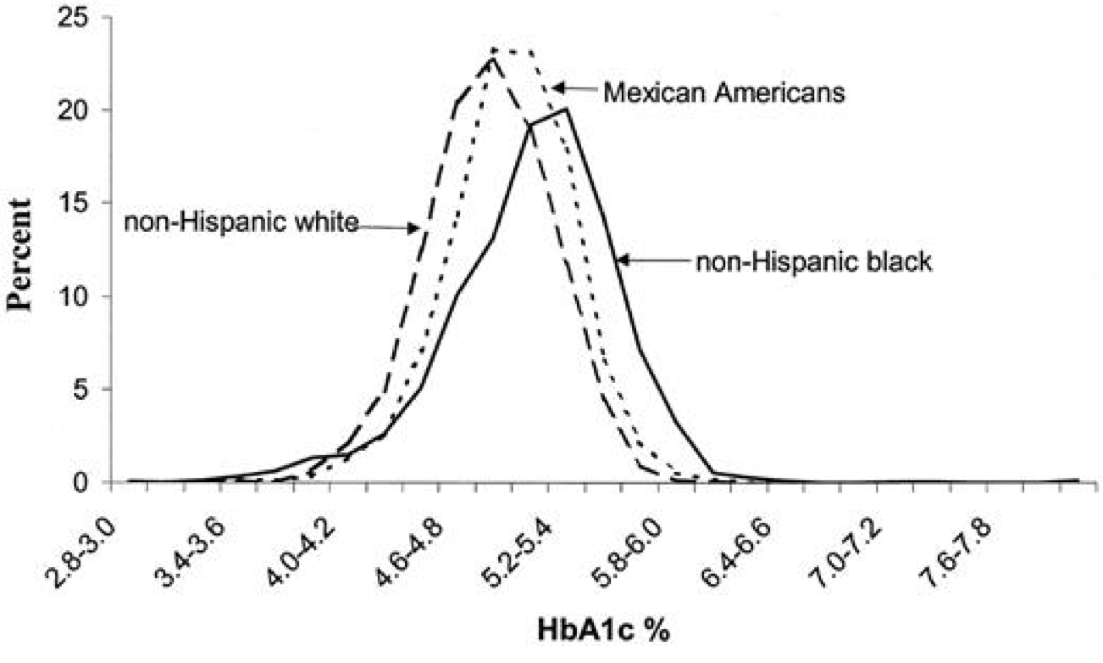
AI needs FAT
HbA1c distribution by ethnicity in U.S. children and young adults ages 5–24 yr (NHANES-3, 1988–1994) [Saaddine et al., 2002]
•Hemoglobin A1c (HbA1c): widely used as a measure of risk for the development of diabetic complications [Herman et al., 2012, Edelman et al., 2004, McCarter et al.. 2004]
Notes:
The third issue and final issue that we as data scientists are struggling with today is building models that stand the test of “Fairness”. Lets look at some examples. The data in this plot tells us that children and young adults with different ethnicities are bound to have different distributions of HbA1c values just within the US. Any model that ignores this variation will optimize for the ethnicity that is most prevalent in the underlying dataset on which it was trained. Not just ethnicity but age, gender and even social determinants can often lead to significant variation and AI that is not tuned to estimate and eliminate such bias will produce biased models.

Slide 30
Example: Differential Treatment by Race
James, a 65-year-old Black male and David, a 65-year-old white male, both have coronary artery disease. On Sunday afternoon, both men experience chest pain and shortness of breath and are rushed to the ED by their spouses.
Both men are seen by the same ED physician and are both diagnosed as having an acute myocardial infarction (a heart attack). Yet the clinical recommendations and interventions offered are different and James is treated less aggressively
How do we determine that the two patient are being treated fairly? [Arora et a. 2018]

Slide 31
Measurement & Mismeasurement of Fairness
Notes:
First a few housekeeping items
The literature on Fairness is vast and multi-faceted. It is not possible to cover it in the span of a few hours. We focus on topic which in our opinion are most relevant and indispensable to fairness within the context of healthcare. Talk about Fairness metrics

Slide 32
How we are categorized through data affects how we will be treated
Frank Pasquale in The Black Box Society
Notes:
Ankur talked earlier about data encoding, who is encoding the data and why feeds into the questions regarding bias and fairness

Slide 33
Discrimination: Treatment vs. Impact
Discrimination: The unjust or prejudicial treatment of different categories of people or things, especially on the grounds of race, age, or sex
(Oxford Dictionary)
Disparate Treatment: The treatment depends on class membership
Example: implicit bias leading to differences in treatment in acute coronary syndrome
Disparate Impact: The treatment appears to be neutral, but it impacts the protected class
Example: hospital relocation and access to care for minority classes
[Barocas, S. and Selbst 2016]

Slide 34
Fairness & Predictive Performance
Fairness Measurement What are the different ways to measure Fairness
Predictive Performance How well is the model performing
Calibration How good is the model calibration
Intervention & Allocation How are the insights from the model being used to intervene

Slide 35
Protected Classes & Proxy Variables
Protected Classes & Potential Surrogates
Age
Sex
Race / ethnicity
Insurance status
Disability, functional status
Zip code / census tract
Costs of care / utilization
Marital status
Disease conditions: HIV, mental health
Genetic results: BRCA
Many variables of interest correlate with protected class.
Not all are considered illegitimate to use in decision making. [ e.g., educational qualifications in hiring decisions. ]
Many papers have proposed methods to identify and mitigate “proxy discrimination”. [ Based on correlations or causal paths in DAGs ]

Slide 36
Model Performance and Fairness
Differences in performance
Limited features
Skewed distributions
Limited data availability
Distribution of Error across sub-populations
Different models with the same reported accuracy can have a very different distribution of error across population
Understanding disparities in predicted outcome
Skewed Proxies
External processes not captured in data

Slide 37
Example: Differential Treatment by Race
James, a 65-year-old Black male and David, a 65-year-old white male, both have coronary artery disease. On Sunday afternoon, both men experience chest pain and shortness of breath and are rushed to the ED by their spouses.
Both men are seen by the same ED physician and are both diagnosed as having an acute myocardial infarction (a heart attack). Yet the clinical recommendations and interventions offered are different and James is treated less aggressively
How do we determine that the two patient are being treated fairly? [Arora et a. 2018]

Slide 38
Type | Description | Formulation | Motivation | Flaws
Unawareness | Do not include the sensitive attribute as a feature in the training data | C=c(x, A) = c(X) | Intuitive, easy to use and legal support (disparate treatment) | There can be many highly correlated features(e.g. neighborhood) that are proxies of the sensitive attribute(e.g. race)
Demographic Parity / Independence / Statistical Parity | The outcomes must be equal | C is independent of A: P₀ [C = c] = P₁ [C = c] ∀ c ∈ {0,1} | Legal Support: “four-fifth rule” prescribes that a selection rate for any disadvantaged group that is less than four-fifths of that for the group with the highest rate. | Ignores any possible correlation between Y and A e.g., rules out perfect predictor C=Y when base rates are different (i.e. P₀ [Y=1] ≠ P₁ [Y=1]) laziness: if we hire the qualified from one group and random people from the other group, we can still achieve parity
Equalized odds / Separation / Positive Rate Parity | Different groups deal with similar odds | C is independent of A conditional on Y: P₀ [C = r | Y = y] = P₁ [C = r | Y = y] ∀ r, y | Optimality compatibility: C=Y is allowed. Penalize laziness: it provides incentive to reduce errors uniformly in all groups. | It may not help closing the gap between two groups
Predictive Rate Parity / Sufficiency | The performance of the predictive model should be the same for different groups | Y is independent of A conditional on C: P₀ [Y = y| C= c] = P₁ [Y = y| C= c] ∀ y, c ∈ {0,1 | Optimality compatibility: C=Y satisfies Predictive Rate Parity. Equal chance of success(Y=1) given acceptance(C=1) | It may not help closing the gap between two groups
Individual Fairness | similar individuals should be treated similarly | D(M(X),M(X’))≤ d(X,X’) | Rather than focusing on group, as individuals, we tend to care more about the individuals. Besides, individual fairness is more fine-grained than any group-notion fairness | It is hard to determine what is an appropriate metric function to measure the similarity of two inputs
Counterfactual Fairness | How do the outcome change if the values of the sensitive variables change | P[C_{A← 0}=c|X, A=a]=P[C_{A← 1}=c|X, A=a] | Counterfactual fairness provides a way to check the possible impact of replacing only the sensitive attribute | The idea is very ideal. In practice, it is hard to reach a consensus in terms of what the causal graph should look like and it is even harder to decide which features to use
Teredesai, PAKDD '20
Notes:
Fairness in ML has been an area of active research for the last few years. Late 2000s to late 2010s We will focus on definitions as they relate to healthcare, that said we will not
Going deeper into the types of fairness we can start to study the foundations systematically. For example, due to the Unawareness bias, eliminating sensitive attributes from training data does not guarantee that highly correlated features will not act as proxies.
Similarly, it may not be easy to accomplish predictive rate parity or sufficiency for multiple cohorts in the dataset. <CLICK>
Unawareness: excluding race from a model that predicts outcomes following acute MI
Demographic parity: ensure positive rates (I.e. rates of intervention) are the same across groups defined by race
Equalized odds:
The limitation of this weaker notion is that we can trade false positive rate of one group for false negative rate of another group.
Predictive parity:
Individual fairness:
Counterfactual fairness: if the black man had been white, what services would have been offered

Slide 39
The Impossibility
Theorem of
FAIRNESS
Demographic Parity, Predictive Rate Parity and Equalized Odds are mutually exclusive theoretically
Drew Fudenberg, David K. Levine, Fairness, risk preferences and independence: Impossibility theorems, Journal of Economic Behavior & Organization, Volume 81, Issue 2, 2012, Pages 606-612, https://doi.org/10.1016/j.jebo.2011.09.004.
Notes:
There is actually the impossibility theorem of fairness that proves demographic parity, predictive rate parity, and equalized odds to be mutually exclusive. Thus solving for Fairness in AI is not guaranteed as a solution to many ML usecases. <CLICK>

Slide 40
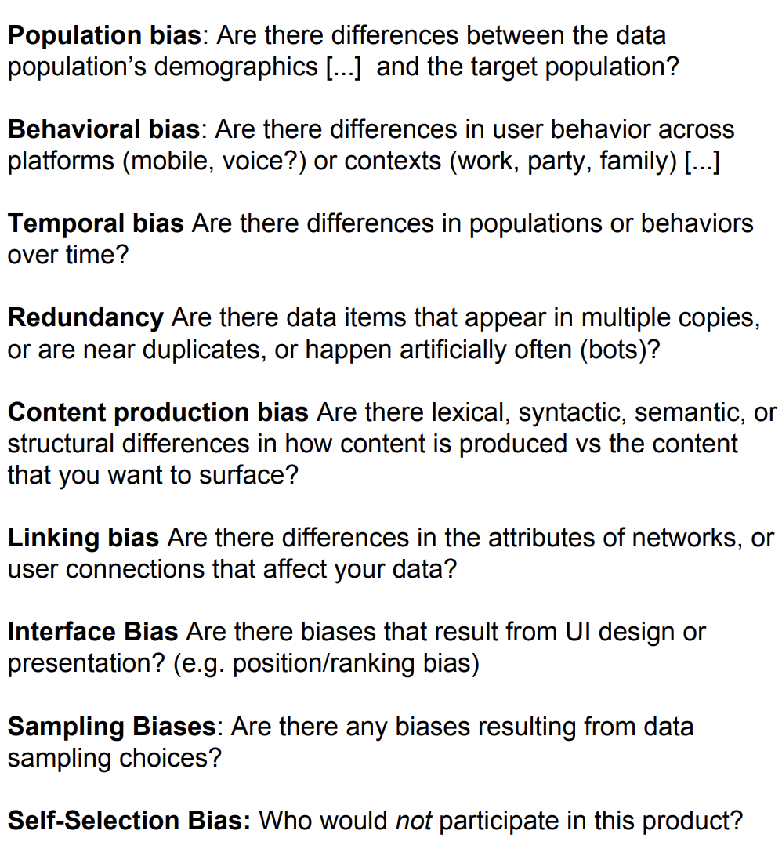
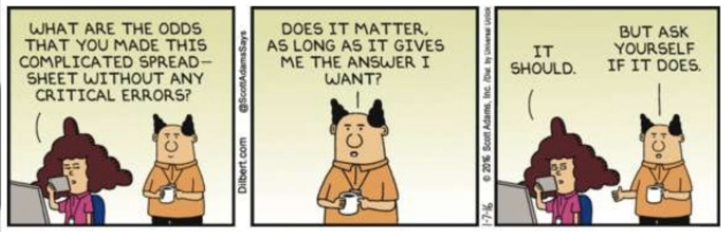
Data Bias
[Crawford 2017; Gebru et al 2018]

Slide 41
Algorithm & Composition Bias
Algorithmic Bias
What are the downstream consequences of model choice or even hyperparameter choice?
Do algorithm assumptions lead towards biased models e.g., Naïve Bayes
Composition/Team Bias
Knowledge gaps in team
Consultation with stakeholders and domain experts
Representation of people affected

Slide 42
Bias: Outcomes & Clinical Perspective
Model Performance
Allocation of Services
Clinical Outcomes
[Rajkomar et al 2018]

Slide 43
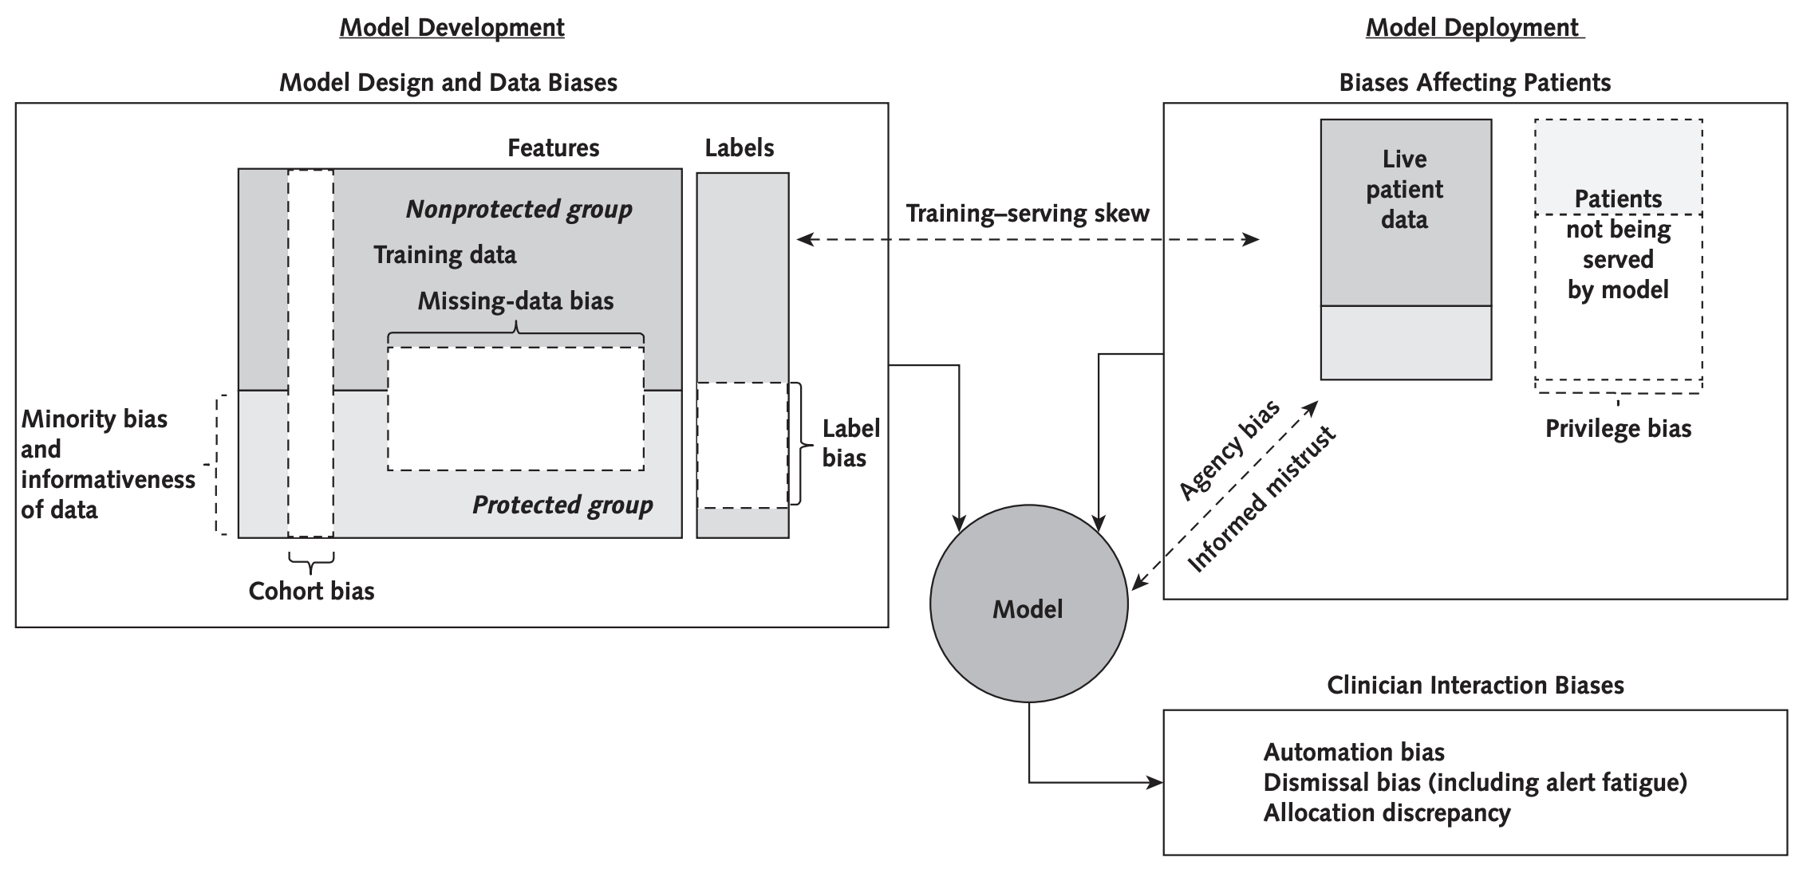
How Biases in Healthcare are interrelated
[Rajkomar et al 2018]

Slide 44
Trade-off in Fairness in ML
Performance vs. Fairness The performance of a model may decrease as it becomes more fair
Fairness vs. Explainability Since explainability and performance often have an inverse relationship, a similar relationship is observed for fairness

Slide 45
Fairness vs. Performance
Trade-off
The predictive performance of a model depends on the dataset, fairness criteria and the algorithm
In general, however, fairness negatively impacts performance because it diverts the objective from accuracy only to both accuracy and fairness. Therefore, a trade-off is needed
Notes:
There are additional tradeoff to be made in predictive performance and fairness and being aware of these challenges always helps in mitigating mistakes both in training and in scoring.

Slide 46
Fairness/Performance Trade-off & Beneficence
Beneficence: An ethical principle that providers must do everything they can to benefit the patient
Since the removal/reduction of bias could possibly reduce predictive performance e.g., adversarial training could increase fairness, it could also compromise overall prediction accuracy (especially the accuracy for non-protected groups). Thus undermining the principle of beneficence
Challenge: How do we simultaneously reduce bias and maintain satisfactory model prediction performance?

Slide 47
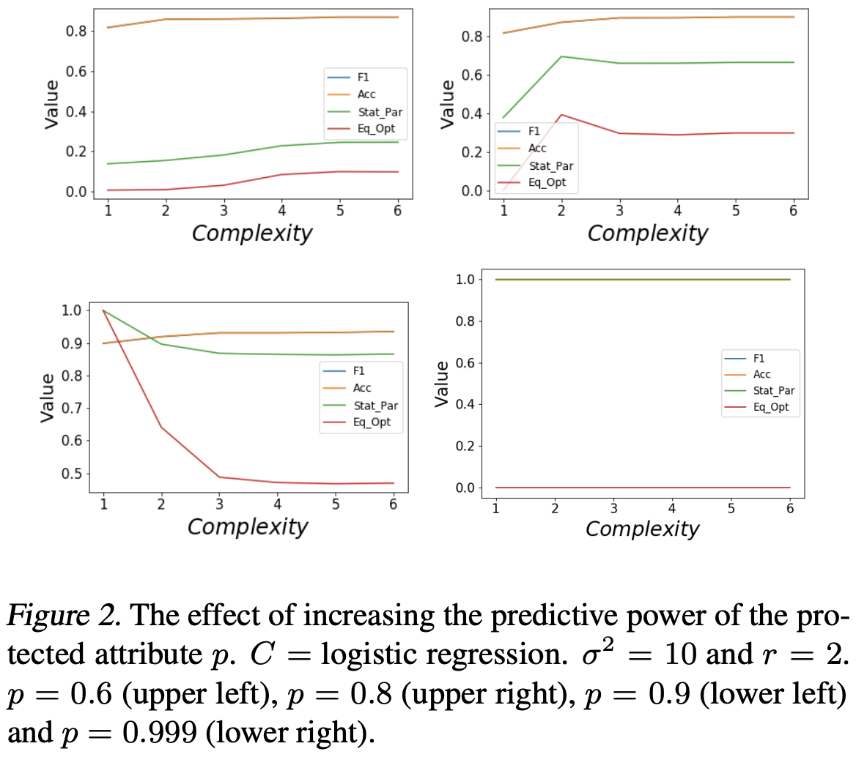
Trade-offs: Fairness vs. Explainability
The relationship between interpretability and fairness is complex and follow four different trends depending on the correlations between protected, non-protected attributes and class labels
Interpretability-fairness trade-offs do not depend on group imbalance
[Jabbari et al 2020]
Notes:
Work in this area is somewhat in its infancy. For interpretability, instead of choosing a context-specific metric, we use the number of features available to the classifier as our measure of model complexity. Fewer the number of features available to the classifier, lower the complexity of the classifier and higher the interpretability.
(1) fairness violation increases as model complexity increases (upper left), (2) fairness violation increases initially and then decreases (upper right), (3) fairness violation decreases (lower left), and (4) fairness violation remains constant (lower right).

Slide 48
Fairness/Explainability Trade-off
Explainability of ML models is supposed to bring about greater scrutiny of models and thus the possibility of fair and equitable models
However simplification of models may also bring about performance degradation as well as less fair models [Kleinberg and Mullainathan 2019]
The trade-off is thus three way: Fairness vs. Performance vs. Explainability
Domain specific guidance should be used to help navigate this complex trade-off landscape

Slide 49
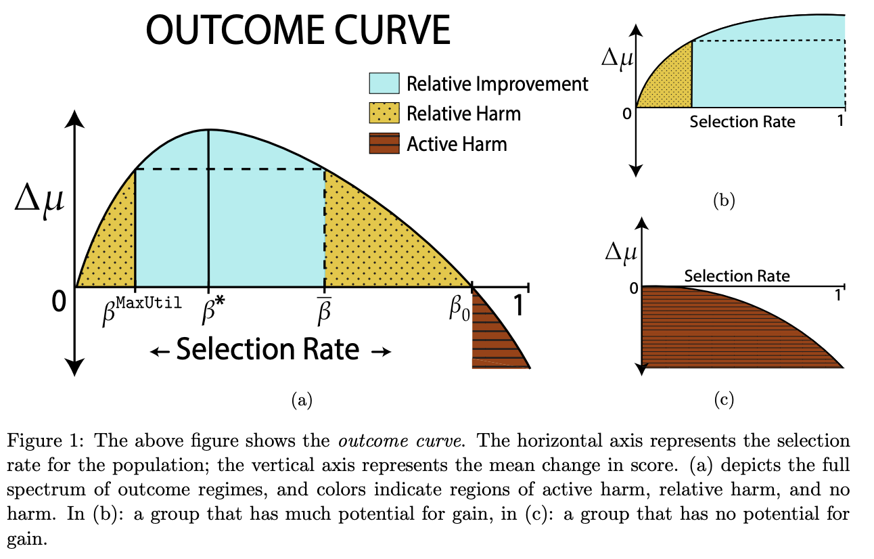
Long Term Trade-offs?
Under what circumstances does fairness criteria do indeed promote the long-term well-being of protected groups over time
In standard classification setting such scenarios are not considered
What if we introduce a one-step feedback model that exposes how decisions change the underlying population over time?
[Liu et al 2020]

Slide 50
Data Collection: Disability and Fairness
Problem: For better predictability, it is critical to gather data that include people with disabilities and to ensure that these data are not completely subsumed by data from presumed “normative” populations
Conundrum: Data collection in this context would also lead to issues related to confidentiality and privacy e.g., potentially dangerous for subjects
Multi-dimensional Problem: Disability status has multiple dimensions, varies in intensity and impact, and varies changes over time. The simple protected vs. other class framework may not suffice
Notes:
especially as regards disability status, might make collecting these data difficult (for developers) or dangerous (for subjects)

Slide 51
Data: Trouble with Labels
In healthcare the ground truth can be subjective in nature
Mental health evaluations, psychological assessments, pain assessment by clinicians vs. patients, patient reported outcomes
Racial and sex/gender biased disparities have been observed for pain assessment across multiple studies
Optimizing for the wrong label can lead to biased outcomes

Slide 52
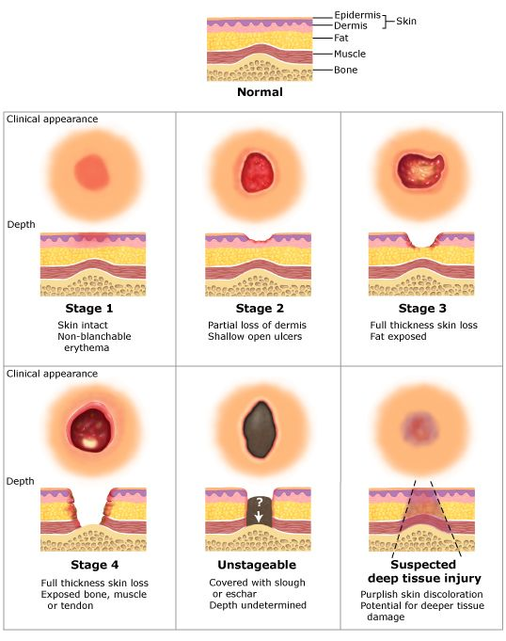
Data: Trouble with Labels: Pressure Injury
“Localized damage to the skin and underlying soft tissue, usually over a bony prominence or related to a medical or other device.” NPUAP
Multiple risk assessment exist for pressure injury (PI). The Braden Scale is the most widely used scale
All measurement scales for PI are highly subjective in nature
Notes:
The injury occurs as a result of intense and/or prolonged pressure, or pressure in combination with shear
Marker of poor overall prognosis
May contribute to premature mortality in some patients
Commonly seen in high-risk populations (elderly and very ill)
Vary by clinical setting, and is a potentially preventable condition

Slide 53
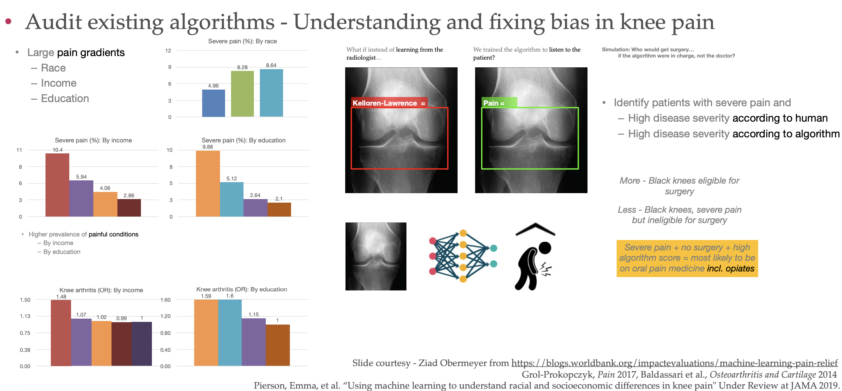
Data: Trouble with Labels: Knee Pain
Notes:
As you can see a significantly larger share of people of color or those with low income or education report being in severe pain in the U.S. A plausible explanation for this might be that such people are more likely to suffer from painful conditions: for example, individuals with a high school or less are 60% more likely to suffer from arthritis of the knee compared with people who have graduate degrees.
However, conditioning on such outcomes does not appreciably reduce the “race gap” in pain. For example, you can look at two people with very similar x-rays: the patterns in the above figure still hold at every level of disease severity discerned by medical professionals from the x-ray. There could be explanations for this, too: for example, stress can make an ailment more painful; there could be differences in access to/uptake of therapies to reduce pain, etc.
But, let’s take a step back for a second. What do we mean when we say that there is a persistent “race gap” in pain? Let’s zoom in on the osteoarthritis case:
Someone complains of pain in their knee
Doctor orders an x-ray and finds it to “look normal.”
Doctor decides that pain must have another cause.
Maybe the doctor is wrong: where does the checklist by which he scores/grades the x-ray come from? In this case, from two researchers who studied coal miners in Lancashire, England in the 1950s. Those original papers that underlie the objective grading systems used to diagnose knee arthritis today did not mention the race of the subjects – perhaps because there was no heterogeneity along this dimension in the study population. Be that as it may, that’s what doctors use today: a grading scheme based on a 1950s, likely mostly white, English population. Could the doctors be under-diagnosing knee problems among minorities and disadvantaged segments of the population? Sure
This is where Dr. Obermeyer and co. had a good idea: train the algorithm on the level of pain reported by the patients instead

Slide 54

Data: Generalization
In sub-Saharan Africa, women are diagnosed with breast cancer younger, on average, than are their peers in developed countries, and their disease is more advanced at diagnosis. Diagnostic AI tools trained on mammograms from Europe are primed to identify disease in its early stages in older women [Nordling 2019]
Data security and access concerns have been raised about allowing developers to access such data from low-income countries
Notes:
Companies offer to pay for such data, he says, which might tempt cash-strapped national health systems or individual researchers to part with patient data, perhaps without thinking hard about the rights of the those whose data they are sharing. A number of developing countries are introducing data-protection laws, but in those countries where law enforcement is lax, such regulations could be circumvented.

Slide 55
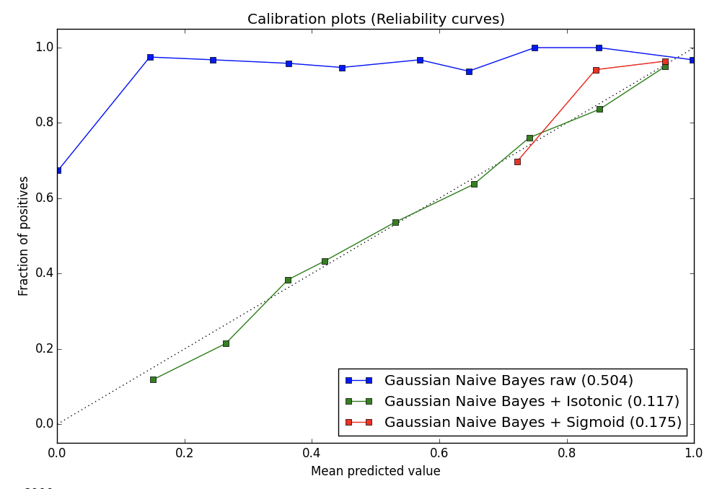
Fairness and Calibration
Calibration: If we look at the set of people who receive a predicted probability of p, we would like a p fraction of the members of this set to be positive instances of the classification problem [Dawid 1982]
If we are concerned about fairness between two groups G1 and G2 (e.g. African-American and white patients) then we would like this calibration condition to hold simultaneously for the set of people within each of these groups as well [Flores et al 2016]
It is not feasible for certain notions of fairness
[Kleinberg et al 2016; Pleiss et al 2017]
Notes:
When feasible, it has a unique optimal solution that can be achieved through post-processing of existing classifiers but is not feasible in practice
Cases in which calibration and relaxed Equalized Odds are compatible, the penalty of equalizing cost is amplified if the base rates between groups differ significantly. This is expected, as base rate differences are what give rise to cost-disparity in the calibrated setting.
Even if fairness is reached in expectation, for an individual case, it may be hard to accept that occasionally consequential decisions are made by randomly withholding predictive information, irrespective of a particular person’s feature representation. In this paper we argue that, as long as calibration is required, no lower-error solution can be achieved.
It is impossible to achieve calibration while also satisfying Equalized Odds. Even if the Equalized Odds conditions are relaxed substantially – requiring only that weighted sums of the group error rates match – it is still problematic to also enforce calibration.
Seeking equality with respect to a single error rate (e.g. false-negatives, as in the income prediction experiment) will necessarily increase disparity with respect to the other error. This may be tolerable (in the income prediction case, some employees will end up over-paid) but could also be highly problematic (e.g. in criminal justice settings). Finally, we have observed that the calibrated relaxation is infeasible when the best (discriminatory) classifiers are not far from the trivial classifiers (leaving little room for interpolation). In such settings, we see that calibration is completely incompatible with an equalized error constraint. In summary, we conclude that maintaining cost parity and calibration is desirable yet often difficult in practice. Although we provide an algorithm to effectively find the unique feasible solution to both constraints, it is inherently based on randomly exchanging the predictions of the better classifier with the trivial base rate.
However, this simple post-processing method is fundamentally unsatisfactory: although the post-processed predictions of our information-withholding algorithm are “fair” in expectation, most practitioners would object to the fact that a non-trivial portion of the individual predictions are withheld as a result of coin tosses – especially in sensitive settings such as health care or criminal justice.

Slide 56
The ‘Other’ Impossibility Theorem
Three notions of Calibration and Fairness
Group Calibration: For each group t, and each bin b with associated score v_{b}, the expected number of people from group t in b who belong to the positive class should be a v_{b} fraction of the expected number of people from group t assigned to b
Negative class Balance: Requires that the average score assigned to people of across groups who belong to the negative class should be the same
Positive class Balance: Requires that the average score assigned to people of across groups who belong to the negative class should be the same
Main Result: It is not possible to satisfy all three conditions of calibration and fairness simultaneously
[Kleinberg et al 2016]
Notes:
To take one simple example, suppose we want to determine the risk that a person is a carrier for a disease X, and suppose that a higher fraction of women than men are carriers. Then our results imply that in any test designed to estimate the probability that someone is a carrier of X, at least one of the following undesirable properties must hold: (a) the test’s probability estimates are systematically skewed upward or downward for at least one gender; or (b) the test assigns a higher average risk estimate to healthy people (non-carriers) in one gender than the other; or (c) the test assigns a higher average risk estimate to carriers of the disease in one gender than the other. The point is that this trade-off among (a), (b), and (c) is not a fact about medicine; it is simply a fact about risk estimates when the base rates differ between two groups. [Kleinberg et al 2016]
A first basic goal in this literature is that the probability estimates provided by the algorithm should be well-calibrated
A second goal focuses on the people who constitute positive instances (even if the algorithm can only imperfectly recognize them): the average score received by people constituting positive instances should be the same in each group. We could think of this as balance for the positive class

Slide 57
Deontic Justice & Fairness in Healthcare ML
Deontic Justice: It is not just the state of affairs of unfairness that matters but also what were the conditions that led to that state of affairs [Binns 2018]
This however requires integrating a perspective from philosophy, history, economics, sociology etc. This becomes a non-trivial problem
Once identified, where should the locus of responsibility be; focus on improving outcomes
When is a particular mistreatment of a protected group worse than the mistreatment of the protected group
Modeling strongly coupled complex systems is hard!

Slide 58
Luck Egalitarianism & Fairness in Healthcare
What type of inequalities are acceptable?
Luck Egalitarianism: Allow inequality in cases which result from people’s efforts and risk taking and do not allow it in cases where it is because of brute luck (skin color, born with debilitating health condition) [Arneson 1989]
Coupled nature of social units: People choices may be limited because they choose to take of sick, elderly, young family members
Free choice are not always free; need to audit systems to determine how stakeholders are being affected?
Notes:
Relevant to a lot of us stuck at home during COVID

Slide 59
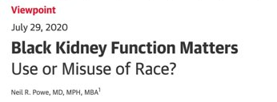
Representational Fairness
Distributive vs representative harms
stereotyping – the tendency to assign characteristics to all members of a group based on stereotypical features shared by a few [Abassi 2019]
Such notions of representational fairness capture many of the most high-profile controversial examples of algorithmic bias [Binns 2018]

Slide 60

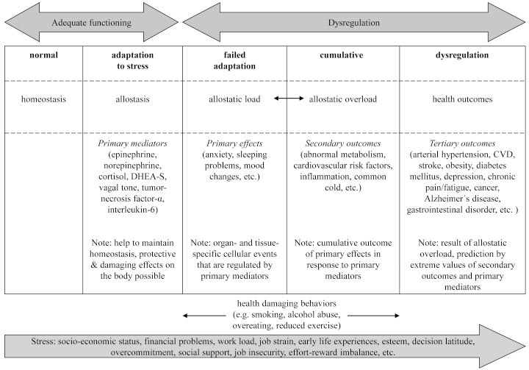
A Lifecycle view of Inequity
What is the cumulative effect of the discrimination faced by a person over the course of a lifetime?
What are the physiologic effects of chronic stressors related to disequity?
[Mauss et al. 2015]
Notes:
? Allostatic load?

Slide 61
Tensions between disparate treatment and disparate impact
Different groups have to be treated differently to maintain fairness.
Humans (clinicians) deal with it on case-by-case basis. But this is not scalable for algorithmic decision making. [Narayanan 2018]
Patient "no show" prediction

Slide 62
Operationalizing Fairness in Healthcare ML

Slide 63
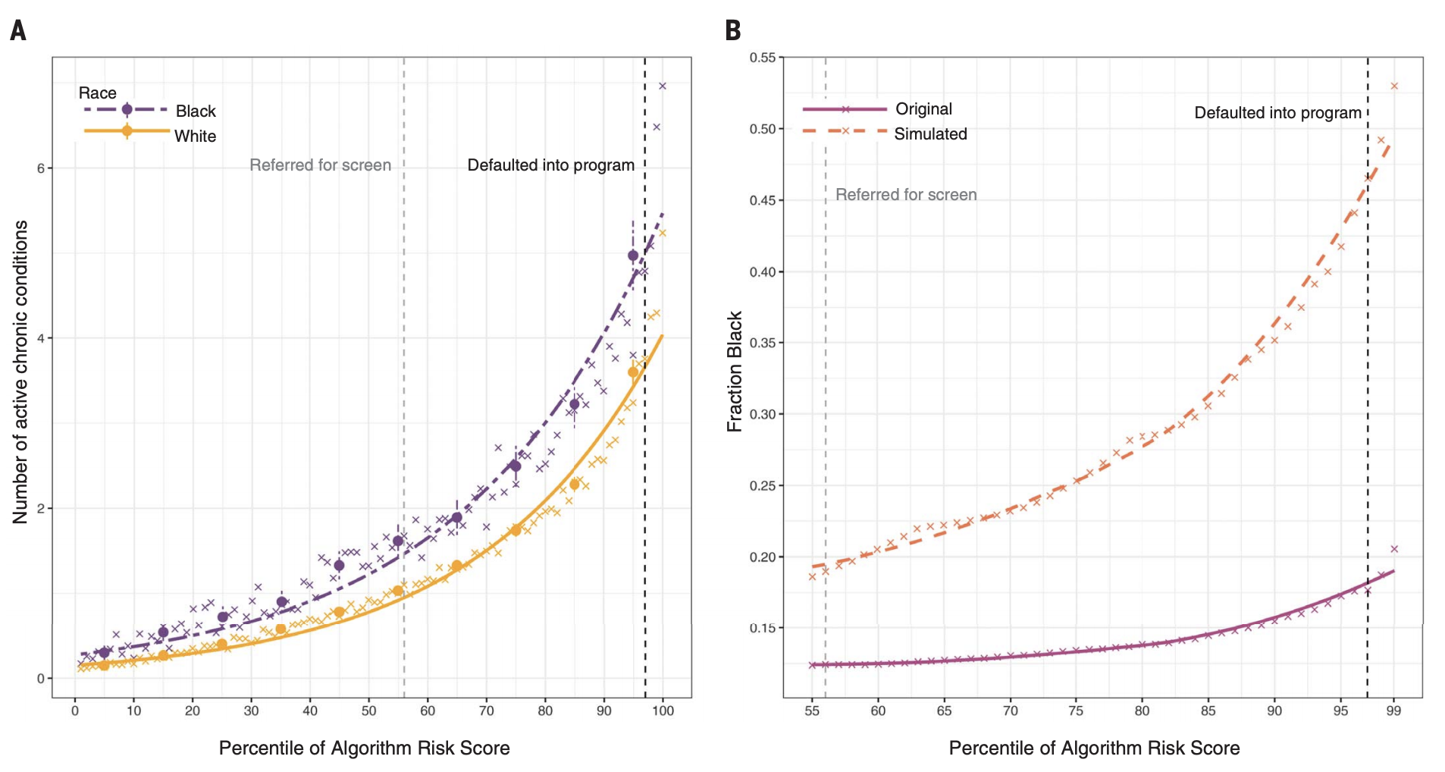
Treatment Effect is not monotonic
The predicted risk of some future outcome e.g., healthcare needs is widely used to target policy interventions under the assumption that the treatment effect is monotonic in that risk. This is however not always true
At the same level of algorithm-predicted risk, Blacks have significantly more illness burden than Whites
Calculate an overall measure of health status, the number of active chronic conditions [or “comorbidity score,” a metric used extensively in medical research to provide a comprehensive view of a patient’s health] by race, conditional on algorithmic risk score.
[Obermeyer et al 2019]
Notes:
a large academic hospital, we identified all primary care patients enrolled in risk-based contracts from 2013 to 2015. Our primary interest was in studying differences between White and Black patients

Slide 64
Healthcare Needs ≠ Healthcare Costs
Algorithm scores are a key input to decisions about future enrollment in a care coordination program
If less-healthy Blacks scored at similar risk scores to more-healthy Whites, leading to substantial disparities in program screening
The algorithm’s prediction on health needs is a prediction on health costs
At a given level of health (again measured by number of chronic illnesses), Blacks generate lower costs than Whites—on average, $1801 less per year, holding constant the number of chronic illnesses
[Obermeyer et al 2019]
Notes:
We quantify this by simulating a counterfactual world with no gap in health conditional on risk. Specifically, at some risk threshold a, we identify the supramarginal White patient (i) with Ri > a and compare this patient’s health to that of the inframarginal Black patient (j) with Rj < a. If Hi > Hj , as measured by number of chronic medical conditions, we replace the (healthier, but supramarginal) White patient with the (sicker, but inframarginal) Black patient. We repeat this procedure until Hi = Hj, to simulate an algorithm with no predictive gap between Blacks and Whites.

Slide 65
Healthcare Needs ≠ Healthcare Costs
Black patients generate very different kinds of costs: for example, fewer inpatient surgical and outpatient specialist costs, and more costs related to emergency visits and dialysis
“These results suggest that the driving force behind the bias we detect is that Black patients generate lesser medical expenses, conditional on health, even when we account for specific comorbidities”
[Obermeyer et al 2019]

Slide 66
Long Term Impact of Fairness
In socio-technical systems, we must consider how algorithms dynamically effect their environment, and the incentives of humans over time.
These kinds of effects are not considered when considering either statistical or individual notions of fairness in one-shot learning settings
Risk of readmission models and different incentive structures and programs
Notes:
Is this where adjusting the threshold for a protected group in a binary classifier might be relevant?? ie RoR?

Slide 67
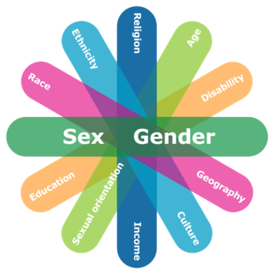
Fairness Gerrymandering (Intersectionality)
Intersectionality: the interconnected nature of social categorizations such as race, class, and gender as they apply to a given individual or group, regarded as creating overlapping and interdependent systems of discrimination or disadvantage [Oxford Dictionary]
Intersectionality is susceptible to (intentional or inadvertent) fairness gerrymandering where a classifier appears to be fair on each individual group, but not for subgroups
Notes:
Simpson's paradox

Slide 68
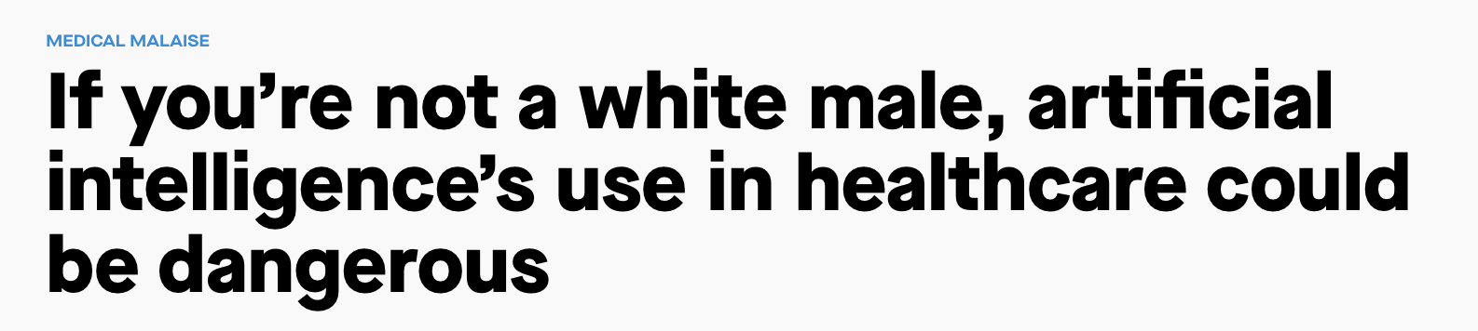
ML Problem: Intersectional Fairness
The investigation of intersectional fairness, i.e., combination of multiple sensitive attributes, is relatively lacking in current research [47], [48]. Take bias mitigation for example, current work generally focus on one kind of bias. Although this may increase model fairness in terms of a specific bias, it is highly possible that the model is still biased from the intersectional perspective.

Slide 69
Fairness Gerrymandering (Intersectionality)
Statistical notions of fairness across exponentially (or infinitely) many subgroups, defined by a structured class of functions over the protected attributes
This interpolates between statistical definitions of fairness, and recently proposed individual notions of fairness, but it raises several computational challenges. It is no longer clear how to even check or audit a fixed classifier to see if it satisfies such a strong definition of fairness
The Computational problem of auditing subgroup fairness for both equality of false positive rates and statistical parity is equivalent to the problem of weak agnostic learning (Computationally hard in the worst case)
However, it also suggests that common heuristics for learning can be applied to successfully solve the auditing problem in practice [Kearns et al 2017]

Slide 70
Multiaccuracy
Multiaccuracy: A strong notion of subgroup fairness. Models should be unbiased, overall as well as on but on every identifiable subpopulation
Given: Black-box access to a classier C, and a relatively small validation set drawn from some representative distribution D
Audit C to determine whether the predictor satisfies multiaccuracy.
If auditing reveals that the predictor does not satisfy multiaccuracy, one could aim to post-process C to produce a new classier C’ that is multiaccurate, without adversely affecting the subpopulations where C was already accurate [Kim et al 2019]

Slide 71
Multiaccuracy: Illustration
Even with a ‘good` classifier, it may still exhibit biases on significant subpopulations when evaluated on a different sample distribution
Scenario: Minority populations are underrepresented in the distribution used to train C vs. testing with different distributions
Example: A disease prediction task based on real individuals, where the phenotype to disease relation is designed to be different for different subgroups [Kim et al 2019]
40,000 patient sampled from the UK Biobank with 60 features

Slide 72
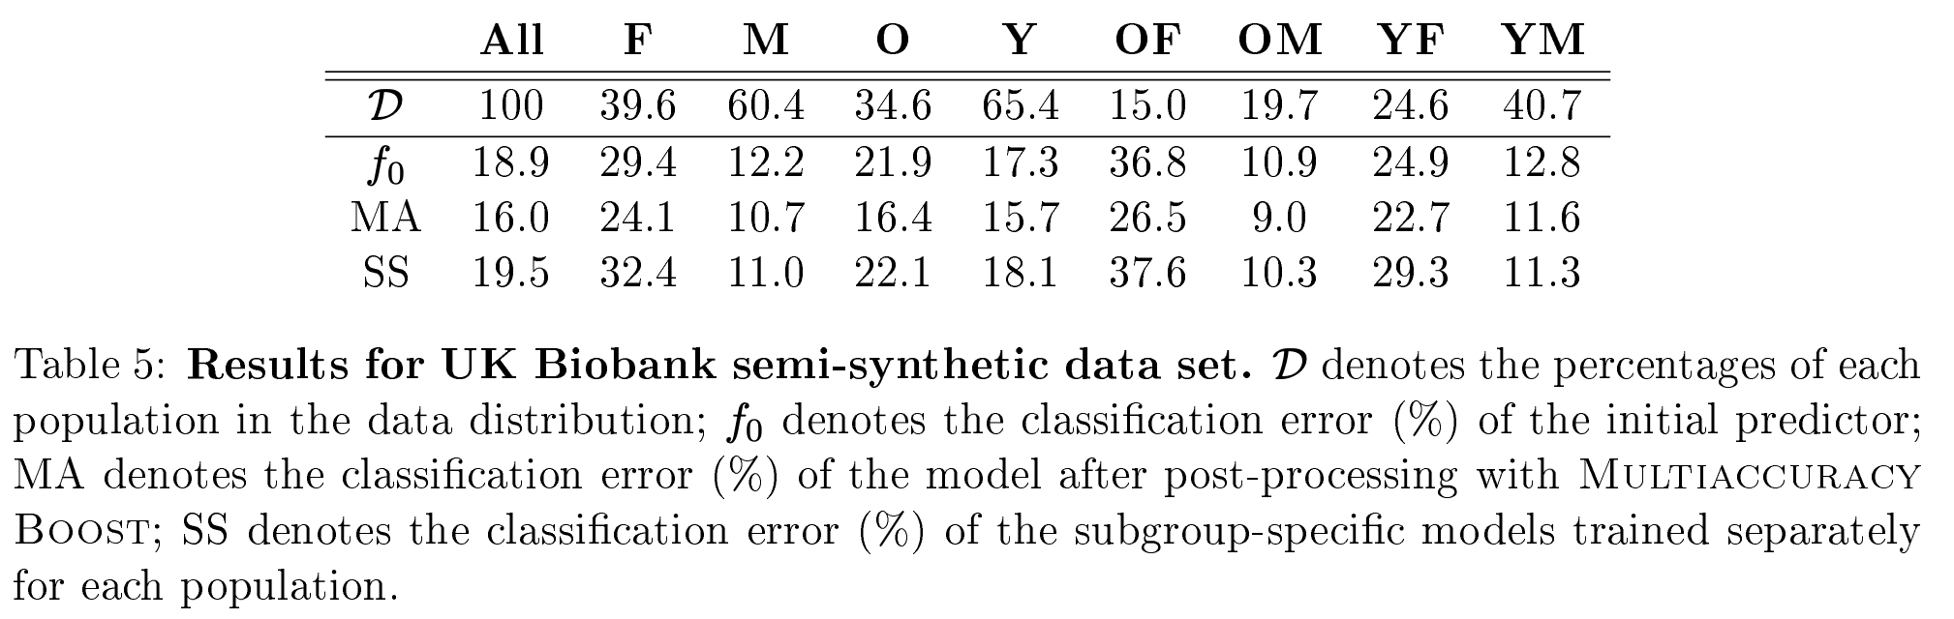
ML Problem: Multiaccuracy
Generate a synthetic disease outcome for each subgroup, divide the data set into subgroups (Gender & Age)
For each subgroup, create synthetic binary labels using a different polynomial function of the input features with different levels of difficulty
Notes:
four groups based on gender male (M) and female (F) and age young (Y) and old (O)

Slide 73
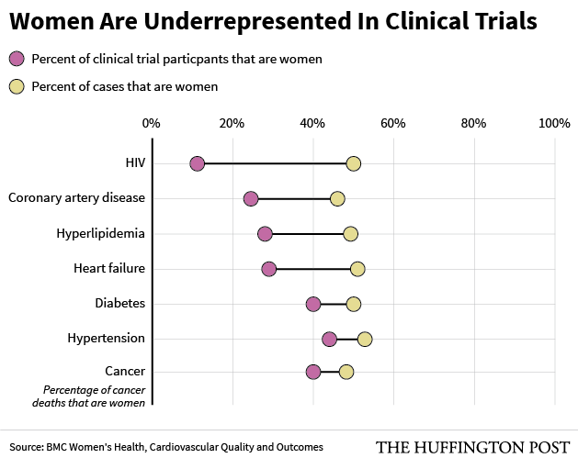
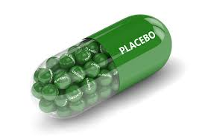
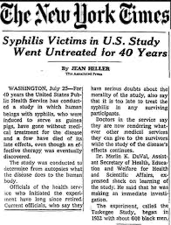
ML Problem: Exploration vs. Exploitation
Notes:
use of placebo in RCT
Tuskeegee airmen study
Pregnancy as a protected class for research. (does this slow learning for women as study subjects

Slide 74
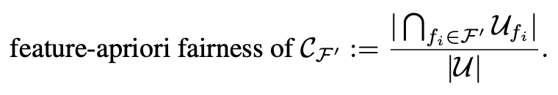
Process Fairness vs. Outcome Fairness
Process Fairness is ensuring that the process is fair and not just the outcome
One way to measure it is by estimating the degree to which people consider the usage various features to be fair in a model (intuitive moral sense)
Let U denote the set of all members of society, and F denote the set of all possible features that might be used in the decision-making process
Feature-Apriori Fairness: Without a priori knowledge of how feature usage affects outcomes
[Grgic-Hlaca et al 2016]
Notes:
Note that a user’s judgment about a feature may change after they learn how using the feature might affect the decision outcomes. For instance, a user who initially considered a feature unfair for use in predicting recidivism risk might change their mind and deem the feature fair to use after learning that using the feature significantly improves the accuracy of prediction. Similarly, learning that using a feature might increase or decrease disparity in decision outcomes for different demographic groups (e.g., whites vs. blacks or men vs. women) might make a user change their opinion on the fairness of using that feature in decision making.

Slide 75
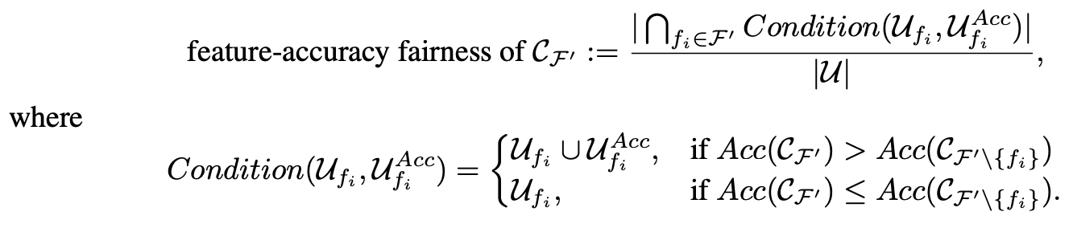
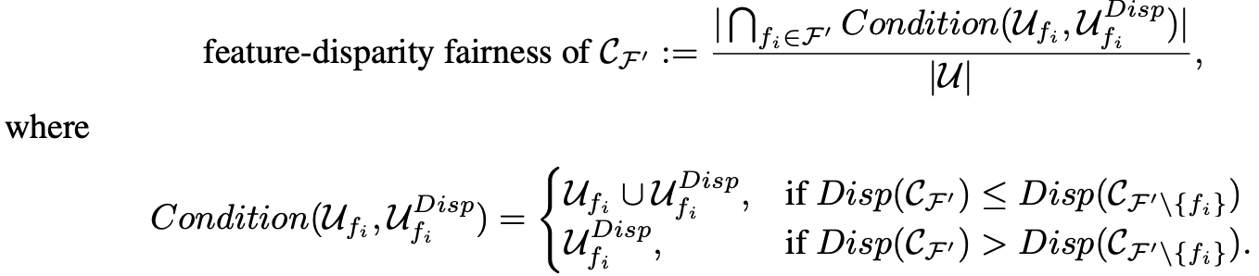
Process Fairness vs. Outcome Fairness
Feature-Accuracy Fairness: Fair to use if it increases the accuracy of the classifier
Feature-Disparity Fairness: Fair to use even if it increases a measure of disparity (i.e. disparate impact or disparate mistreatment) of the classifier
[Grgic-Hlaca et al 2016]

Slide 76
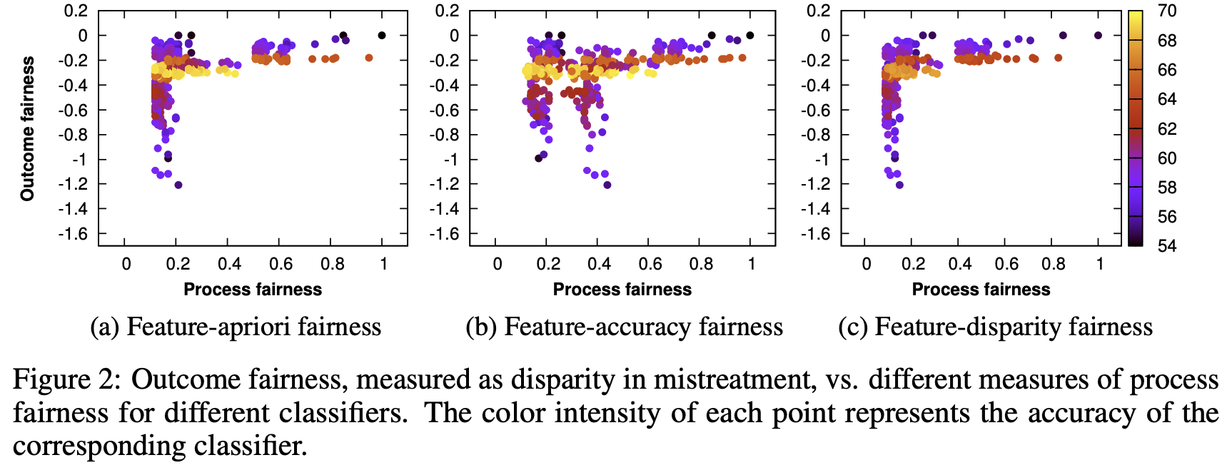
Process Fairness vs. Outcome Fairness
Process Fairness also exhibits Performance-Fairness trade-off
Notes:
We present the accuracy of each of 512 classifiers in Figure 1 against the three notions of fairness: feature-apriori fairness, feature-accuracy fairness and feature-disparity fairness for our results. We make the following interesting observations: First, for very low value of process fairness (vertically spread cluster on the left side in all three figures), one could achieve almost all possible values of accuracy. Upon further investigation, we find out that the these clusters correspond to the classifiers when features judged to be highly unfair (gender, race and age) are present in the classifier feature set
It is possible to achieve high accuracy or high process fairness, but not both simultaneously.

Slide 77
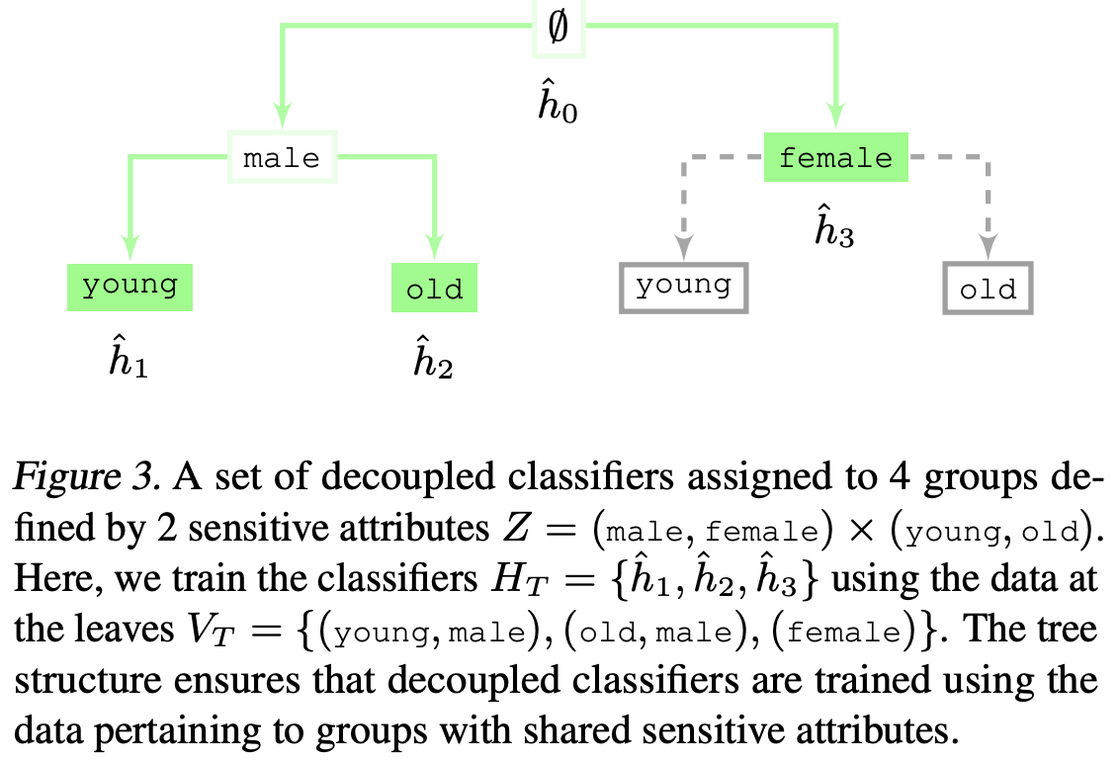
Decoupled Classifiers
A model that ignores group membership may impose heterogenous trade-offs between groups
Decoupled classifiers: Train a classifier for each group using data from that group
Conditions: Each group should prefer their assigned model to (i) a pooled model that ignores group membership (rationality) and (ii) the model assigned to any other group (envy-freeness)
[Ustun et al 2018; Herbert-Johnson et al 2018]
Notes:
Consider, for example, training a medical diagnostic using a dataset with sensitive attributes such as age, gender and ethnicity. In this case, a model that ignores group membership may not be beneficent as it may impose inevitable performance trade-offs between heterogeneous groups
Decoupling is a simple technique that will recover the most accurate model for each group in an ideal setting where we are given unlimited data. In practice, however, it must be used with care since it may harm groups with insufficient data.

Slide 78
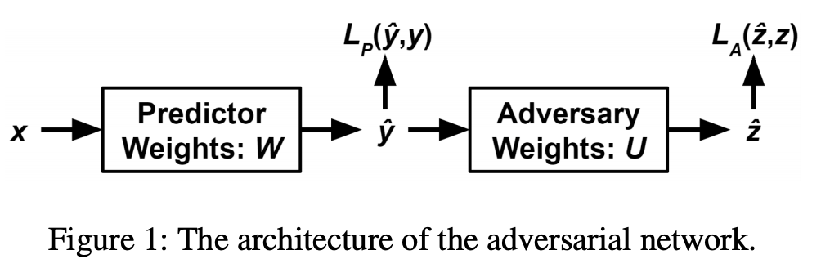
Adversarial Debiasing
Suppose we want to ensure that an adversary cannot infer the target variable
For Demography Parity, the adversary gets the predicted label Yˆ . Intuitively, this allows the adversary to try to predict the protected variable using nothing but the predicted label
For Equality of Odds, the adversary gets Yˆ and the true label Y
For Equality of Opportunity on a given class y, we can restrict the training set of the adversary to training examples
General, Model-Agnostic and Optimal (under certain conditions)
[Beutel et al 2017; Zhang et al 2018]
Notes:
The goal of the predictor is to prevent the adversary from doing this

Slide 79
Best Practices

Slide 80
Recommendations
Model Design
Data Collection
Training
Evaluation
Deployment and Review
[Rajkomar et al 2018]
Notes:
Review the goal of the ML model with diverse and representative stakeholders
Discuss ethical concerns about model use and / or misuse
Determine which features and which patient groups should be considered protected or surrogates of protected
Assess if the protected groups are adequately represented.

Slide 81
Impossibility of Fairness in the real world
Unfair practices do not exist in a vacuum but are embedded in the larger context of historical, social and political realities [Glymour et al 2019; Herington 2020]
Measures of algorithmic bias assume that an algorithm which is fair in the abstract will be fair in the world.
Centuries of injustice continue to permeate society and continue to be responsible for race- and gender-based inequality
Implicit vs explicit biases can be difficult and / or impossible to adjust for and demand societal changes
Notes:
Building on prior work [14], I recount three ways in which existing injustice causes key assumptions of these measures of fairness fail: (a) historical injustice, (b) unmodelled injustice, and (c) the legitimacy of using sensitive attributes to rectify both kinds of injustice [Glymour et al 2019]

Slide 82
Prediction & Policy
Allocation of services, particularly those derived from outputs of machine learning models, must be continually evaluated for evidence of bias to ensure that services are delivered equally across protected groups
The allocation of services will be determined by how clinicians or other end users interact with the model
Is there a disparate impact?
Is the clinical team subject to automation bias or dismissal bias? And how may that differentially affect patient groups?
Opportunity cost

Slide 83
Best Practices: Task Definition
Clearly define the task & model’s intended effects
Try to identify and document unintended effects & biases
Clearly define any fairness requirements
Involve diverse stakeholders & multiple perspectives
Refine the task definition & be willing to abort
[Cramer et al 2019]

Slide 84
Best Practices: Testing
Check that test data matches deployment context
• Ensure test data has sufficient representation
• Continue to involve diverse stakeholders
• Revisit all fairness requirements
• Use metrics to check that requirements are met [Cramer et al 2019]

Slide 85
Best Practices: Deployment
Continually monitor – match between training data, test data, and instances you encounter in deployment – fairness metrics – user reports & user complaints
Invite diverse stakeholders to audit system for biases
Methods/tools to audit for shifts in population
Methods/tools to determine whether a particular error is a one-off issue or is indicative of a systemic problem
Audit existing system for biases (in collaboration with the teams that built the systems whenever possible) [Cramer et al 2019]

Slide 86
Best Practices: Feedback
Continue to monitor – match between training data, test data, and instances you encounter in deployment – fairness metrics – user reports & user complaints
Monitor users’ interactions with system
Consider prohibiting some types of interactions [Cramer et al 2019]

Slide 87
Challenges & Open Questions
Which measures of fairness are most appropriate in a given context?
Which variables are legitimate grounds for differential treatment, and why?
When is disparity between groups acceptable and why?
Should fairness consist of maximizing equal probability of obtaining some benefit, or minimizing the harms to the least advantaged?
In making such tradeoffs, should the decision-maker consider only the harms and benefits imposed within the decision-making context, or also those faced by decision-subjects in other contexts?
What relevance should past, future or inter-generational injustices have?
[Binns 2018]

Slide 88
Challenges & Open Questions
Many aspects of fairness not captured by metrics or data; how do we address those?
How to deal with Fairness Gerrymandering where there is insufficient data for modeling?

Slide 89
Library Demo

Slide 90
FairMLHealth Library
Vision
An extensible Python library dedicated to fairness in machine learning specifically tailored for healthcare with domain knowledge integration
Future Goals & Milestones
Measurement of Fairness in Healthcare Applications
Comparison of classifiers for Fairness and Performance Trade-offs
Arbitrary comparison of protected classes and intersectional classes
Current Release: FairMLHealth 0.1: Alpha Release
Demonstration of measurement and comparison of fairness metrics for a publicly available dataset (MIMIC-3)

Slide 91

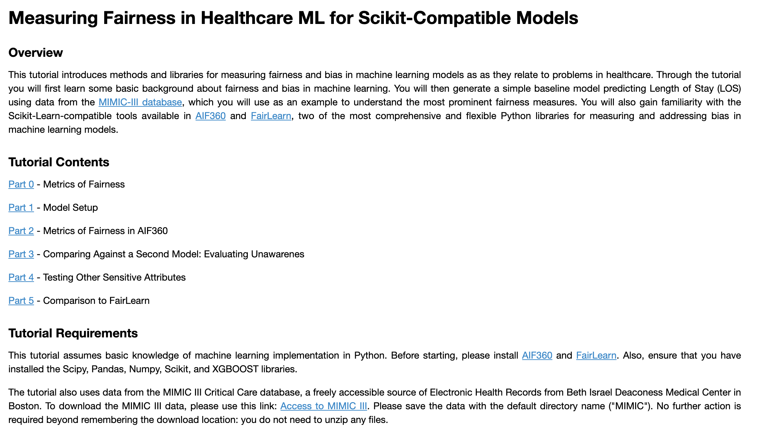
FairMLHealth Library

Slide 92
Recap & Conclusion

Slide 93
Recap
Foundations: Fairness in Healthcare ML
Measurement & Mismeasurement of Fairness
Operationalizing Fairness in Healthcare ML
Domain Challenges in Healthcare ML
Fairness in Healthcare ML in Action
Best Practices
Library Demo
Conclusion
Notes:
As you can tell this is fantastic effort to not just bring the field of Fair and Bias free ML in healthcare under one roof but to make it real with implementation backed release of this library. Today we covered a lot! We began our tutorial with the foundations of Fairness in Healthcare. We developed a working definition and framework of Fairness and how to measure fairness in healthcare. We then discussed operational issues with healthcare examples of the pros and cons of each approach. This also helped us see the fairness techniques across the pipeline of ML implementation.
But much remains to be done in this field. Here are a few things we can do together. (next slide please)

Slide 94
Call to Action: Datasets
Deployment of Enterprise grade AI and ML models in healthcare at multiple locations in the US and internationally
Fairness across multiple locations, settings and cohort

Slide 95

Call to Action: Partner with us! It takes a village
Deployment of Enterprise grade AI and ML models in healthcare at multiple locations in the US and internationally
Fairness across multiple locations, settings and cohort

Slide 96
Call to Action: Resources: Websites
AI Now Institute
Algorithmic Justice League
Berkman Klein Center for Internet and Society
ML Healthcare Resources
Partnership on AI
Notes:
Many organizations and non-profit are focused on Fairness but none exclusively focused on Healthcare AI

Slide 97
Call to Action: Resources: Libraries
Library | Creator | Metrics | Algorithms | Simulations
AIF 360 | IBM | ✅ | ✅
Fairlearn | Hannah Walllach et al | ✅ | ✅
Fairness Comparison | Sorelle Friedler | ✅
Fairness Indicators | Tensorflow | ✅
ML Fairness Gym | Google |  |  | ✅
Themis-ML | Niels Bantilan | ✅ | ✅
And now the FairMLHealth Library
Notes:
A number of libraries are available for measuring bias in ML models. We mainly looked at libraries which allowed for comparison of multiple metrics and algorithms for mitigation.
Ask the audience to suggest if there prominent libraries that may be missing

Slide 98
References
Parikh, Ravi B., Stephanie Teeple, and Amol S. Navathe. "Addressing bias in artificial intelligence in health care." Jama 322, no. 24 (2019): 2377-2378.
Parasuraman, Raja, and Dietrich H. Manzey. "Complacency and bias in human use of automation: An attentional integration." Human factors 52, no. 3 (2010): 381-410.
Agniel, Denis, Isaac S. Kohane, and Griffin M. Weber. "Biases in electronic health record data due to processes within the healthcare system: retrospective observational study." Bmj 361 (2018).
McLintock K, Russell AM, Alderson SL, et al. The effects of financial incentives for case finding for depression in patients with diabetes and coronary heart disease: interrupted time series analysis. BMJ Open2014;4:e005178. doi:10.1136/bmjopen-2014-005178. pmid:25142262
Weizenbaum, Joseph (1976). Computer power and human reason : from judgment to calculation. San Francisco: W.H. Freeman
Adelman, Larry. "Unnatural causes: Is inequality making us sick?." Preventing Chronic Disease 4, no. 4 (2007).
Simkin RJ. Women's health: time for a redefinition. CMAJ. 1995;152(4):477-479.
Byrd, W. Michael, and Linda A. Clayton. "Race, medicine, and health care in the United States: a historical survey." Journal of the National Medical Association 93, no. 3 Suppl (2001): 11S.
Wailoo, Keith. "Sickle cell disease—a history of progress and peril." N Engl J Med 376, no. 9 (2017): 805-807.
de Malave, Florita Z. Louis. Sterilization of Puerto Rican women: a selected, partially annotated bibliography. University of Wisconsin System, Women's Studies Librarian, 1999.
Randall, Vernellia R. "Slavery, Segregation and Racism: Trusting the Health Care System Ain't Always Easy--An African American Perspective on Bioethics." . Louis U. Pub. L. Rev. 15 (1995): 191.
King, M. L. Jr. (1966). National Convention for Medical Committee for Human Rights. Washington, DC. Excerpt from speech retrieved from http://www.goodreads.com/quotes/106932-of-all-the-forms-ofinequality-injustice-in-health-care

Slide 99
References
Almond, Amanda Lee. "Measuring racial microaggression in medical practice." Ethnicity & health 24, no. 6 (2019): 589-606.Barocas, Solon and Hardt, Moritz., Fairness in machine learning, NeurIPS Tutorial, 2017.
Dovidio, John F., Susan Eggly, Terrance L. Albrecht, Nao Hagiwara, and Louis A. Penner. "Racial biases in medicine and healthcare disparities." TPM: Testing, Psychometrics, Methodology in Applied Psychology 23, no. 4 (2016).
Agniel, Denis, Isaac S. Kohane, and Griffin M. Weber. "Biases in electronic health record data due to processes within the healthcare system: retrospective observational study." Bmj 361 (2018).
Parikh, Ravi B., Stephanie Teeple, and Amol S. Navathe. "Addressing bias in artificial intelligence in health care." Jama 322, no. 24 (2019): 2377-2378.
Bierman, Arlene S. "Sex matters: gender disparities in quality and outcomes of care." Cmaj 177, no. 12 (2007): 1520-1521.
Binns, Reuben. "Fairness in machine learning: Lessons from political philosophy." arXiv preprint arXiv:1712.03586 (2017).
Chen, Esther H., Frances S. Shofer, Anthony J. Dean, Judd E. Hollander, William G. Baxt, Jennifer L. Robey, Keara L. Sease, and Angela M. Mills. "Gender disparity in analgesic treatment of emergency department patients with acute abdominal pain." Academic Emergency Medicine 15, no. 5 (2008): 414-418.
Chouldechova, Alexandra, and Aaron Roth. "The frontiers of fairness in machine learning." arXiv preprint arXiv:1810.08810 (2018).
Parasuraman, Raja, and Dietrich H. Manzey. "Complacency and bias in human use of automation: An attentional integration." Human factors 52, no. 3 (2010): 381-410.

Slide 100
References
McLintock K, Russell AM, Alderson SL, et al. The effects of financial incentives for case finding for depression in patients with diabetes and coronary heart disease: interrupted time series analysis. BMJ Open2014;4:e005178. doi:10.1136/bmjopen-2014-005178. pmid:25142262
Weizenbaum, Joseph (1976). Computer power and human reason : from judgment to calculation. San Francisco: W.H. Freeman
Adelman, Larry. "Unnatural causes: Is inequality making us sick?." Preventing Chronic Disease 4, no. 4 (2007).
Almond, Amanda Lee. "Measuring racial microaggression in medical practice." Ethnicity & health 24, no. 6 (2019): 589-606.Barocas, Solon and Hardt, Moritz., Fairness in machine learning, NeurIPS Tutorial, 2017.
Byrd, W. Michael, and Linda A. Clayton. "Race, medicine, and health care in the United States: a historical survey." Journal of the National Medical Association 93, no. 3 Suppl (2001): 11S.
Wailoo, Keith. "Sickle cell disease—a history of progress and peril." N Engl J Med 376, no. 9 (2017): 805-807.
de Malave, Florita Z. Louis. Sterilization of Puerto Rican women: a selected, partially annotated bibliography. University of Wisconsin System, Women's Studies Librarian, 1999.
Randall, Vernellia R. "Slavery, Segregation and Racism: Trusting the Health Care System Ain't Always Easy--An African American Perspective on Bioethics." . Louis U. Pub. L. Rev. 15 (1995): 191.
King, M. L. Jr. (1966). National Convention for Medical Committee for Human Rights. Washington, DC. Excerpt from speech retrieved from http://www.goodreads.com/quotes/106932-of-all-the-forms-ofinequality-injustice-in-health-care

Slide 101
References
Corbett-Davies, Sam., Goel, Sharad., Defining and Designing Fair Algorithms, Tutorials at EC 2018 and ICML 2018.
Corbett-Davies, Sam, and Sharad Goel. "The measure and mismeasure of fairness: A critical review of fair machine learning." arXiv preprint arXiv:1808.00023 (2018).
Cramer, Henriette., Holstein, Kenneth., Jennifer Wortman Vaughan et. al., Translation Tutorial: Challenges of incorporating algorithmic fairness into industry practice, FAT* Tutorial, 2019.
Crawford, Kate The Trouble with Bias, NeurIPS Keynote, 2017.
Dawes, Robyn M., David Faust, and Paul E. Meehl. "Clinical versus actuarial judgment." Science 243, no. 4899 (1989): 1668-1674.
Dresser, Rebecca. "Wanted single, white male for medical research." The Hastings Center Report 22, no. 1 (1992): 24-29.
Friedler, Sorelle A., Carlos Scheidegger, Suresh Venkatasubramanian, Sonam Choudhary, Evan P. Hamilton, and Derek Roth. "A comparative study of fairness-enhancing interventions in machine learning." In Proceedings of the Conference on Fairness, Accountability, and Transparency, pp. 329-338. 2019.
Friedler, Sorelle A., Carlos Scheidegger, and Suresh Venkatasubramanian. "On the (im) possibility of fairness." arXiv preprint arXiv:1609.07236 (2016).
Garcia, M (2017): “Racist in the Machine: The Disturbing Implications of Algorithmic Bias” In World Policy Journal.
Gajane, Pratik, and Mykola Pechenizkiy. "On formalizing fairness in prediction with machine learning." arXiv preprint arXiv:1710.03184 (2017).
Bellamy, Rachel KE, Kuntal Dey, Michael Hind, Samuel C. Hoffman, Stephanie Houde, Kalapriya Kannan, Pranay Lohia et al. "AI Fairness 360: An extensible toolkit for detecting and mitigating algorithmic bias." IBM Journal of Research and Development 63, no. 4/5 (2019): 4-1.

Slide 102
References
Ghassemi, Marzyeh, Tristan Naumann, Peter Schulam, Andrew L. Beam, and Rajesh Ranganath. "Opportunities in machine learning for healthcare." arXiv preprint arXiv:1806.00388 (2018).
Grote, Thomas, and Philipp Berens. "On the ethics of algorithmic decision-making in healthcare." Journal of Medical Ethics 46, no. 3 (2020): 205-211.
Hajian, Sara., Bonchi, Francesco and Castillo, Carlos ., Algorithmic bias: From discrimination discovery to fairness-aware data mining, KDD Tutorial, 2016.
Holstein, Kenneth, Jennifer Wortman Vaughan, Hal Daumé III, Miro Dudik, and Hanna Wallach. "Improving fairness in machine learning systems: What do industry practitioners need?." In Proceedings of the 2019 CHI Conference on Human Factors in Computing Systems, pp. 1-16. 2019.
Hutchinson, Ben., and Mitchell, Margaret., "50 Years of Test (Un) fairness: Lessons for Machine Learning." In Proceedings of the Conference on Fairness, Accountability, and Transparency, pp. 49-58. 2019.
Hutchinson, Ben., and Mitchell, Margaret., Translation Tutorial: A History of Quantitative Fairness in Testing, FAT* Tutorial, 2019.
Jensen, Arthur R. "Bias in mental testing." (1980).
Joseph, Matthew, Michael Kearns, Jamie Morgenstern, Seth Neel, and Aaron Roth. "Rawlsian fairness for machine learning." arXiv preprint arXiv:1610.09559 1, no. 2 (2016).
Kusner, Matt J., Joshua Loftus, Chris Russell, and Ricardo Silva. "Counterfactual fairness." In Advances in Neural Information Processing Systems, pp. 4066-4076. 2017
Kamiran, Faisal, and Toon Calders. “Classifying Without Discriminating.” In Proc. 2nd International Conference on Computer, Control and Communication, 2009.
Kilbertus, Niki, Mateo Rojas Carulla, Giambattista Parascandolo, Moritz Hardt, Dominik Janzing, and Bernhard Schölkopf. "Avoiding discrimination through causal reasoning." In Advances in Neural Information Processing Systems, pp. 656-666. 2017.
Krieger, Nancy. "Discrimination and health inequities." International Journal of Health Services 44, no. 4 (2014): 643-710.

Slide 103
References
Rudin, Cynthia, and Berk Ustun. "Optimized scoring systems: Toward trust in machine learning for healthcare and criminal justice." Interfaces 48, no. 5 (2018): 449-466.
Smedley BD, Stith AY, Nelson AR. Institute of medicine, committee on understanding and eliminating racial and ethnic disparities in health care. Unequal Treatment: Confronting Racial and Ethnic Disparities in Healthcare Washington, DC: National Academies Press; 2003.
Vayena, Effy, Alessandro Blasimme, and I. Glenn Cohen. "Machine learning in medicine: addressing ethical challenges." PLoS medicine 15, no. 11 (2018).
Tamayo-Sarver, Joshua H., Susan W. Hinze, Rita K. Cydulka, and David W. Baker. "Racial and ethnic disparities in emergency department analgesic prescription." American journal of public health 93, no. 12 (2003): 2067-2073.
Thomas SB, Quinn SC. The Tuskegee Syphilis Study, 1932 to 1972: implications for HIV education and AIDS risk education programs in the black community. Am J Public Health. 1991;81(11):1498-1505. doi:10.2105/ajph.81.11.1498
Zhang, Junzhe, and Elias Bareinboim. “Fairness in Decision-Making — the Causal Explanation Formula.” In Proc. 32nd AAAI, 2018.
Liu, Lydia T., Sarah Dean, Esther Rolf, Max Simchowitz, and Moritz Hardt. “Delayed Impact of Fair Machine Learning.” In Proc. 35th ICML, 3156–64, 2018.
Miller, Tim. “Explanation in artificial intelligence: Insights from the social sciences.” arXiv preprint arXiv:1706.07269 (2017).
Nabi, Razieh, and Ilya Shpitser. "Fair inference on outcomes." In Thirty-Second AAAI Conference on Artificial Intelligence. 2018.
Narayanan, Arvind 21 fairness definitions and their politics, FAT* Tutorial, ACM Conference on Fairness, Accountability, and Transparency (ACM FAT*) 2018
Rajkomar, Alvin, Michaela Hardt, Michael D. Howell, Greg Corrado, and Marshall H. Chin. "Ensuring fairness in machine learning to advance health equity." Annals of internal medicine 169, no. 12 (2018): 866-872.
Rajkomar, Alvin, Jeffrey Dean, and Isaac Kohane. "Machine learning in medicine." New England Journal of Medicine 380, no. 14 (2019): 1347-1358.

Slide 104
Appendix

